Slide 1


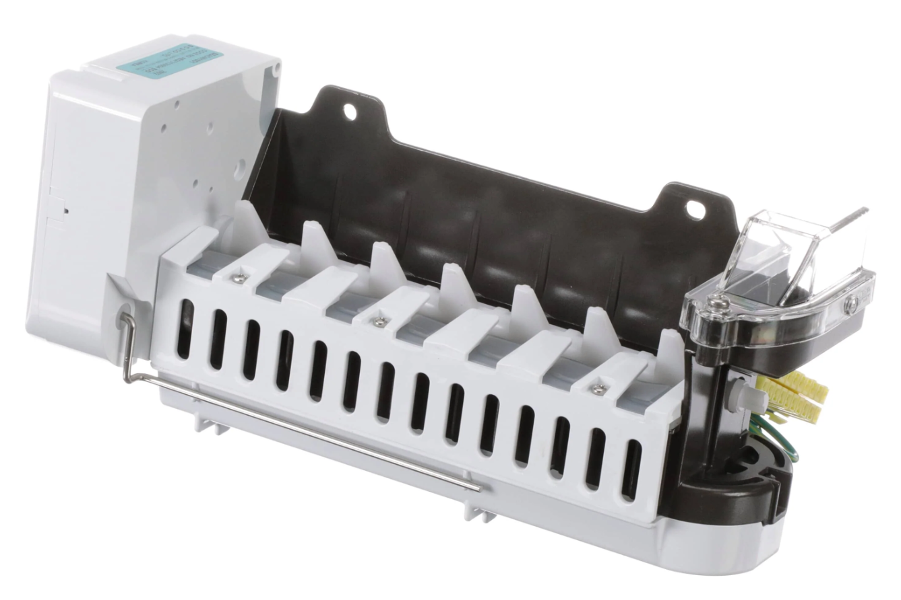
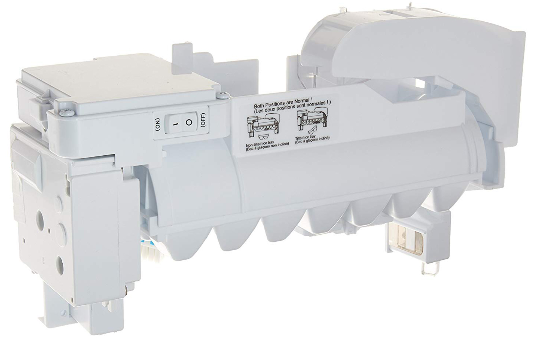
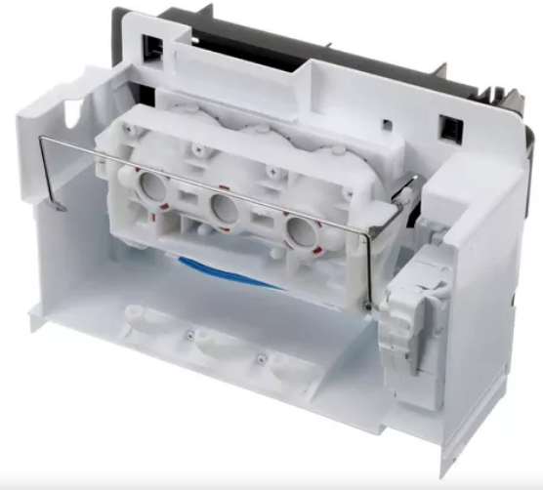
No Ice Checklist Update – August 2025
Icemaker Checklist
These are the current Symptom / Sub-Symptoms that require Icemaker Checklist Usage:
Ice/Water | Not Making Ice (Craft or Standard) | Icemaker Checklist Required
Ice/Water | No Ice [Standard]
Ice/Water | Not making enough ice [Craft]
Ice/Water | No Ice [Craft]
Ice/Water | Not making enough ice [Standard]
Ice/Water | Bad Tasting Ice
Ice/Water | Water Overfilling Tray
Ice/Water Dispenser | Not making enough ice [Craft]
Ice/Water Dispenser | Not Making Ice (Craft or Standard)
Ice/Water Dispenser | Not making enough ice [Standard]
Ice/Water Dispenser | Bad Tasting Ice
Ice/Water Dispenser | No Ice [Craft]
Ice/Water Dispenser | No Ice [Standard]
Ice/Water Dispenser | Water Overfilling Tray
Icemaker | Not Enough Ice
Icemaker | No Ice
Icemaker | Tray will not turn upright
Icemaker | Craft Icemaker
Icemaker | Ice Overflowing the Bin
Icemaker | particles in Ice
Icemaker | Cannot remove the bucket
Icemaker | Water Overfilling Tray
Icemaker | Bad Taste
Icemaker | Mini Cube Icemaker
Icemaker | Not enough Ice Storage Capacity
Icemaker Issues | Can not remove the bucket
Icemaker Issues | No Ice
Icemaker Issues | Not Enough Ice
Icemaker Issues | Ice Overflowing the Bin
Icemaker Issues | Water Overfilling Tray
Icemaker Issues | Not enough Ice Storage Capacity
Icemaker Issues | Tray will not turn upright
Icemaker Issues | Bad Taste
(ThinQ Care)Icemaker/Dispenser | (ThinQ Care)No Ice

Slide 2
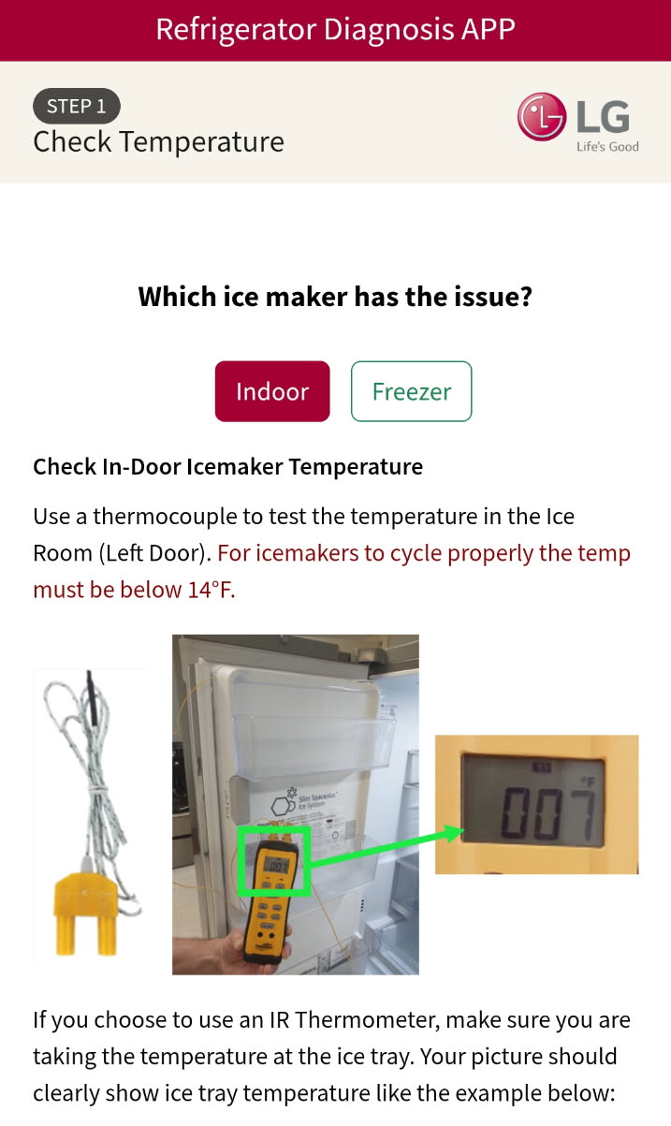
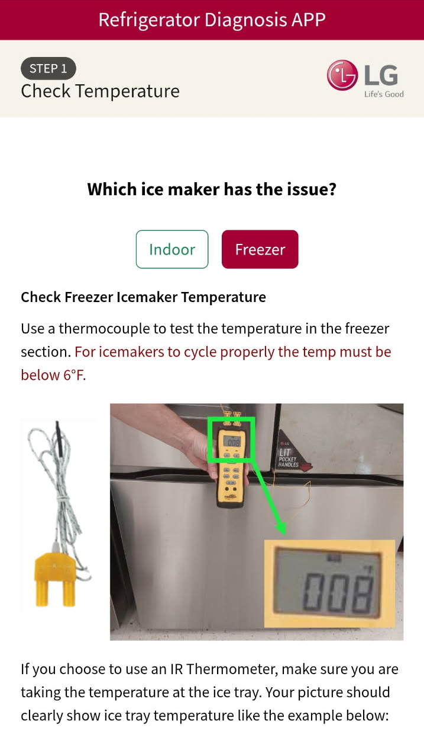
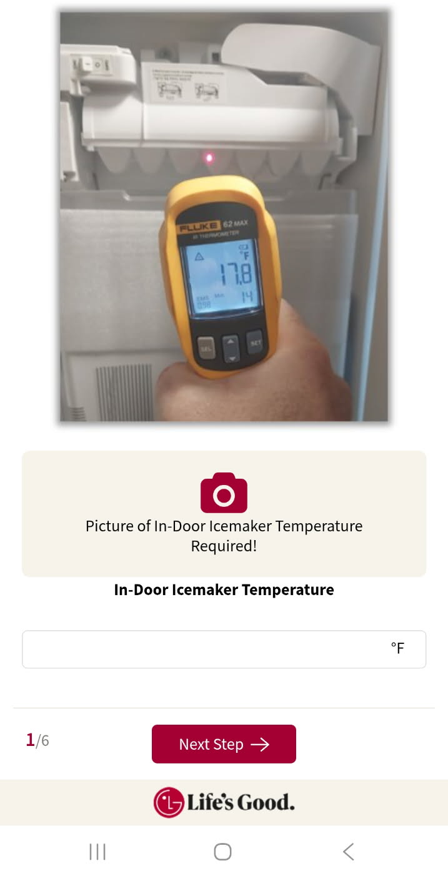
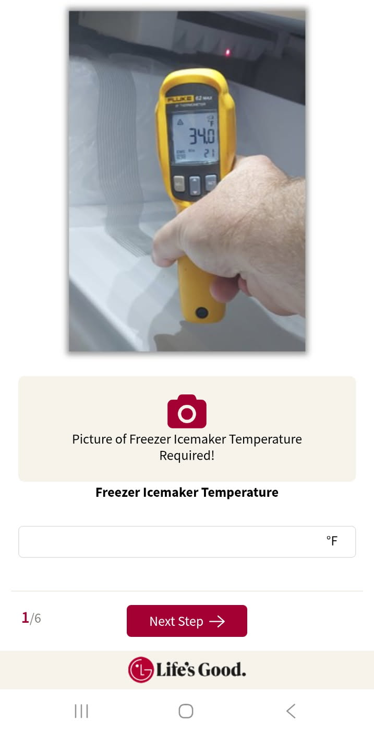
Step 1: Temperature Checks
No Ice Checklist Update – August 2025
Step 1:
Technician will need to…
Select the icemaker that is having an issue.
Measure the temperature in the location of the affected icemaker. (Checking with Thermocouple is recommended).
Take a picture that clearly shows the temperature.
Type in the temperature making sure it matches the temperature in the picture.
What are the reviewers looking for?
That the proper picture(s) were taken. (If using an IR Thermometer make sure and tet temperature directly at the ice tray!)
That the temperature entered matches the temperature in the picture(s).
Note: If the indoor temperature is too warm…tech will also be prompted to measure and enter the freezer temperature also. It is critical that temperatures are entered accurately as it will affect the flow of Step 3. If both temps measure in the correct range, then Step 3 will be skipped.

Slide 3
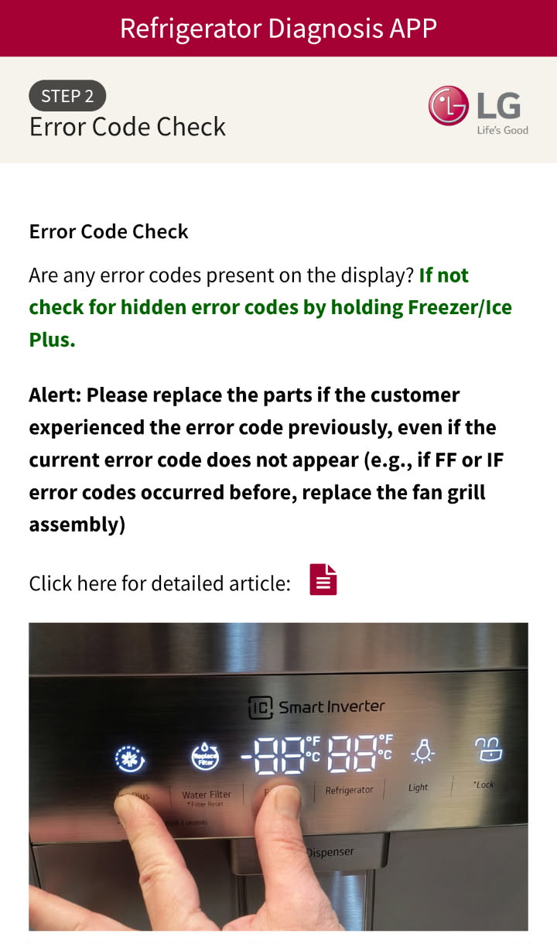
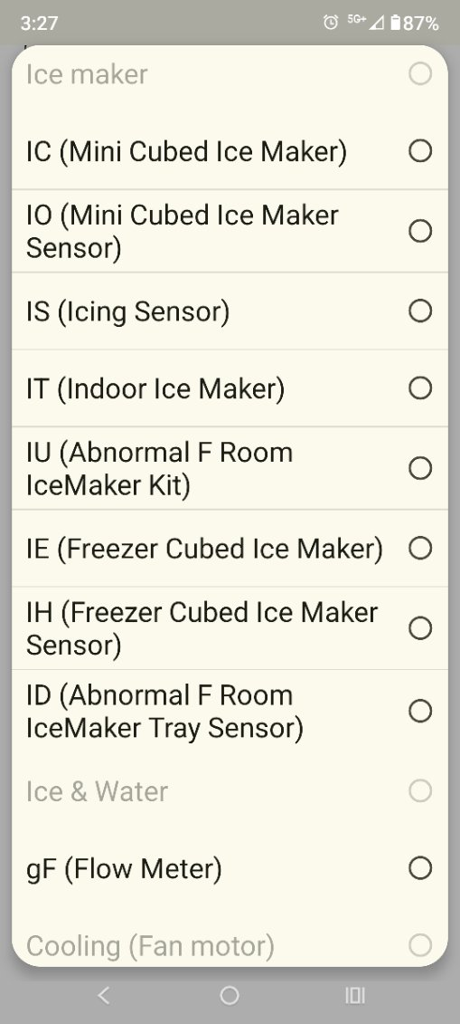
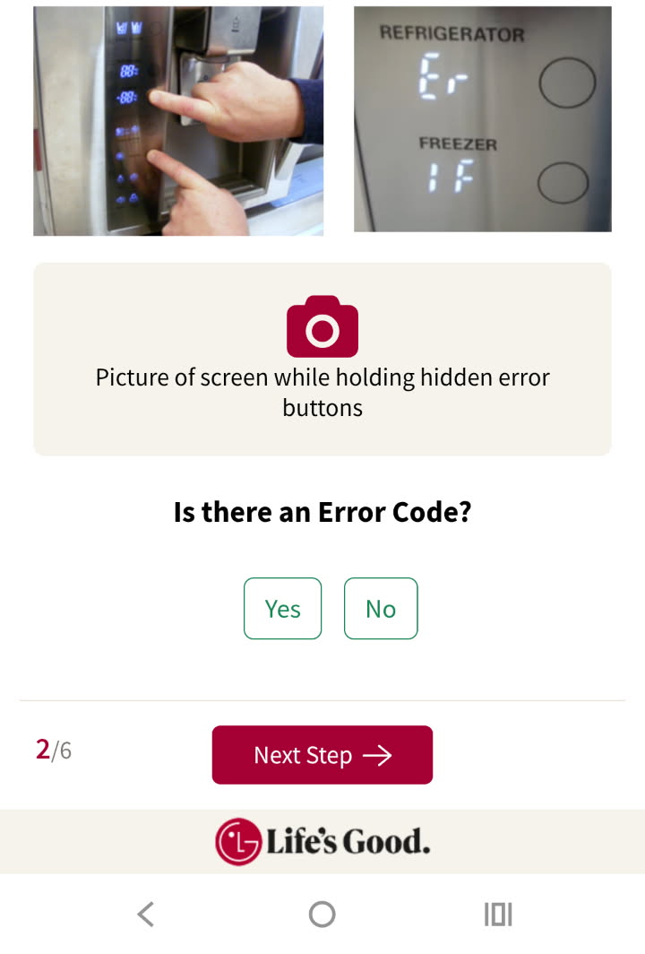
Step 2: Error Code Checks
No Ice Checklist Update – August 2025
Step 2:
Technician will need to…
Check for error codes displayed. If no error code is displayed, check for hidden error codes.
Take a picture that clearly shows the display while checking for hidden errors.
Answer the question, “Is there an Error Code?” If so, select the error code from the list that will appear.
The technician must replace parts accordingly if the customer previously experienced error codes, even if they are not currently visible.
What are the reviewers looking for?
That the proper picture of display was taken.
That the tech selected the error code appropriately.
Note: If the unit does not have a digital display where error codes can be checked, simply take a picture of the controls. Or if the buttons are too far apart to reach and take a picture at the same time, take a picture attempting to press the buttons.

Slide 4
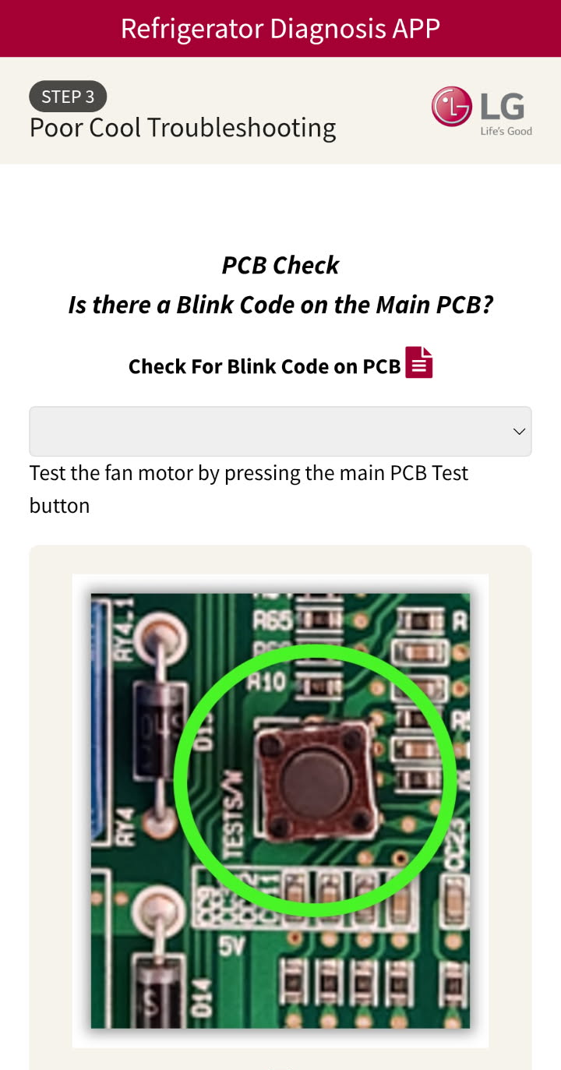
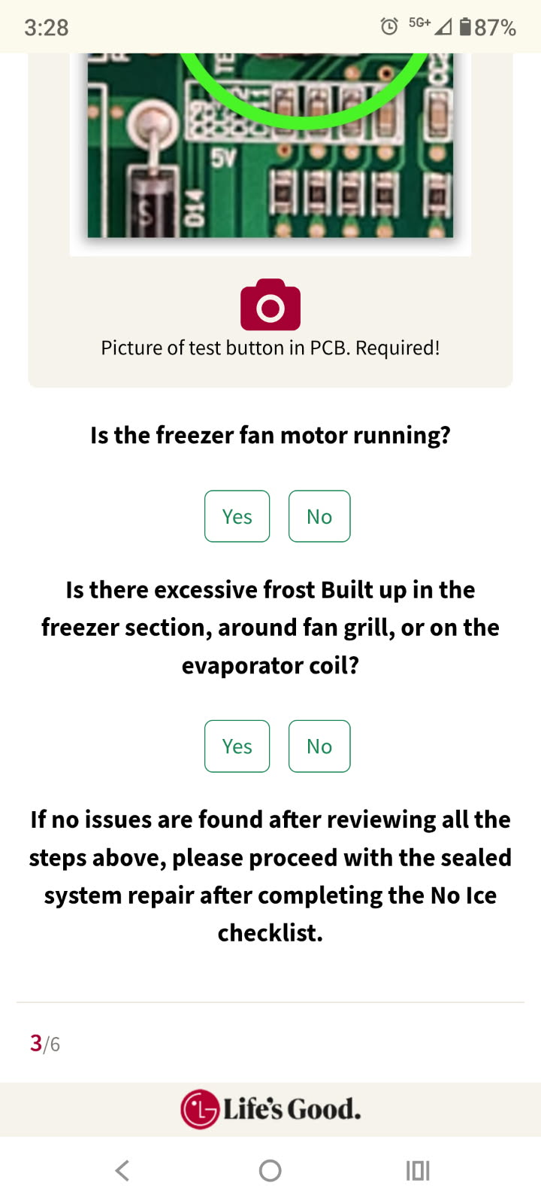
Step 3: Poor Cool Troubleshooting
No Ice Checklist Update – August 2025
Note: Step 3 will be skipped if temperatures entered at step 1 are normal, and pictures showed normal temperatures.
Step 3:
Technician will need to…
Check for blink codes on the Main PCB.
Press the Test Mode button on the Main PCB to run all fans and compressor.
Take a picture of the test button on the Main PCB to show they entered Test Mode.
Answer the questions that populate to troubleshoot the No/Poor Cool issue.
What are the reviewers looking for?
That the tech took a proper picture showing the Test Mode Button on the Main PCB. (and that any other required pictures during troubleshooting were taken).
To see what parts were recommended and if those parts were installed on Step 5.
Note: The troubleshooting steps will change based on temperatures entered on Step 1. These picture to the right is just an example.

Slide 5
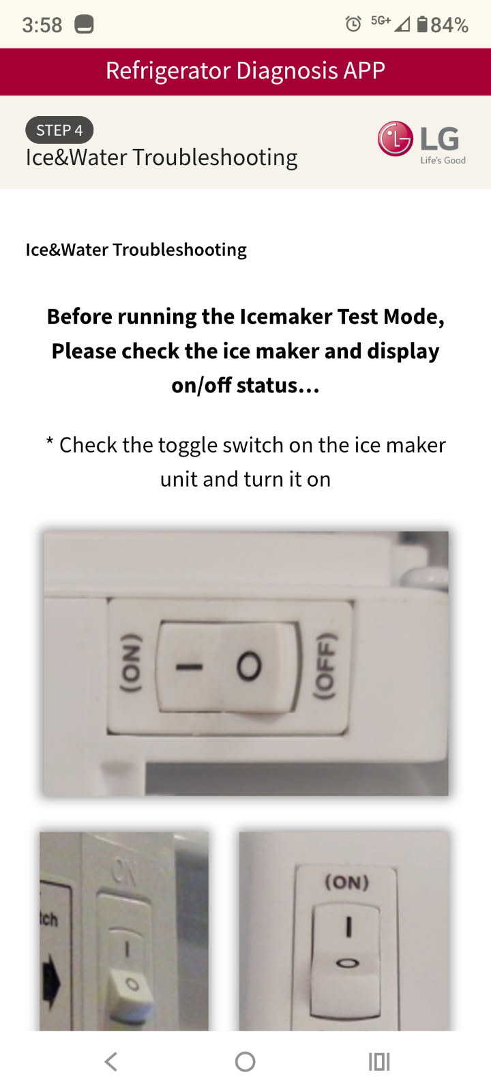
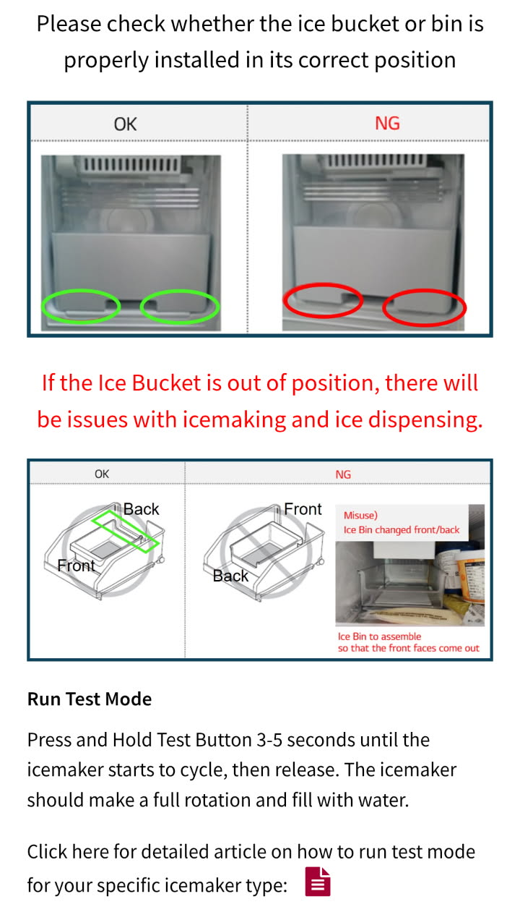
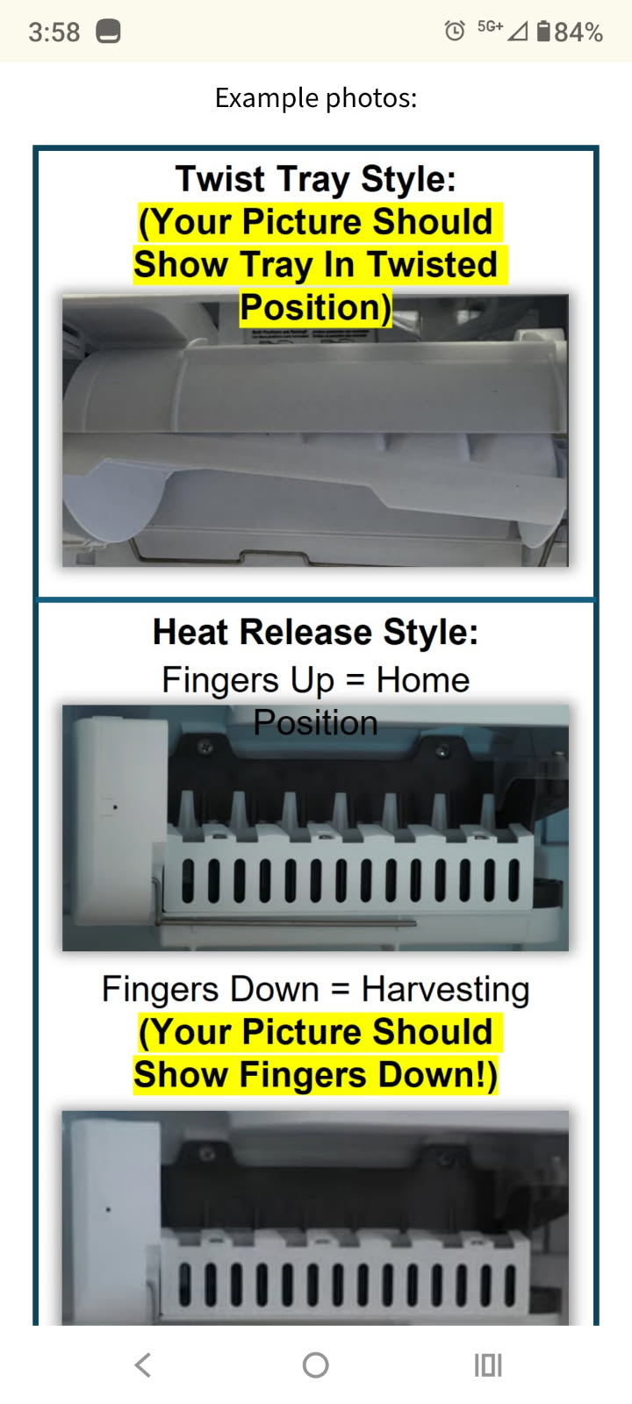
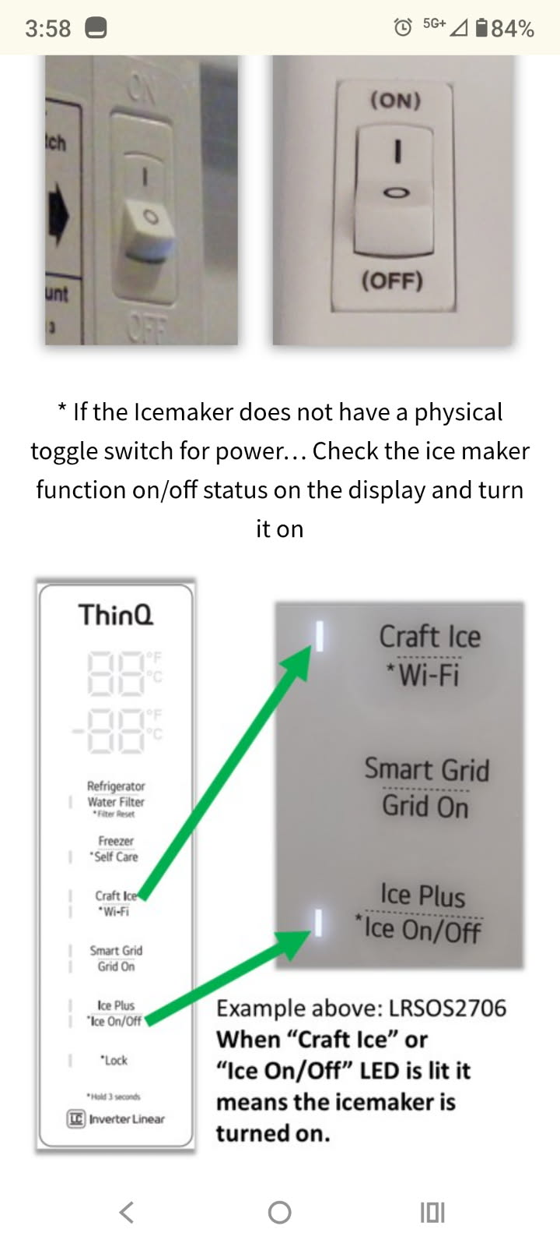
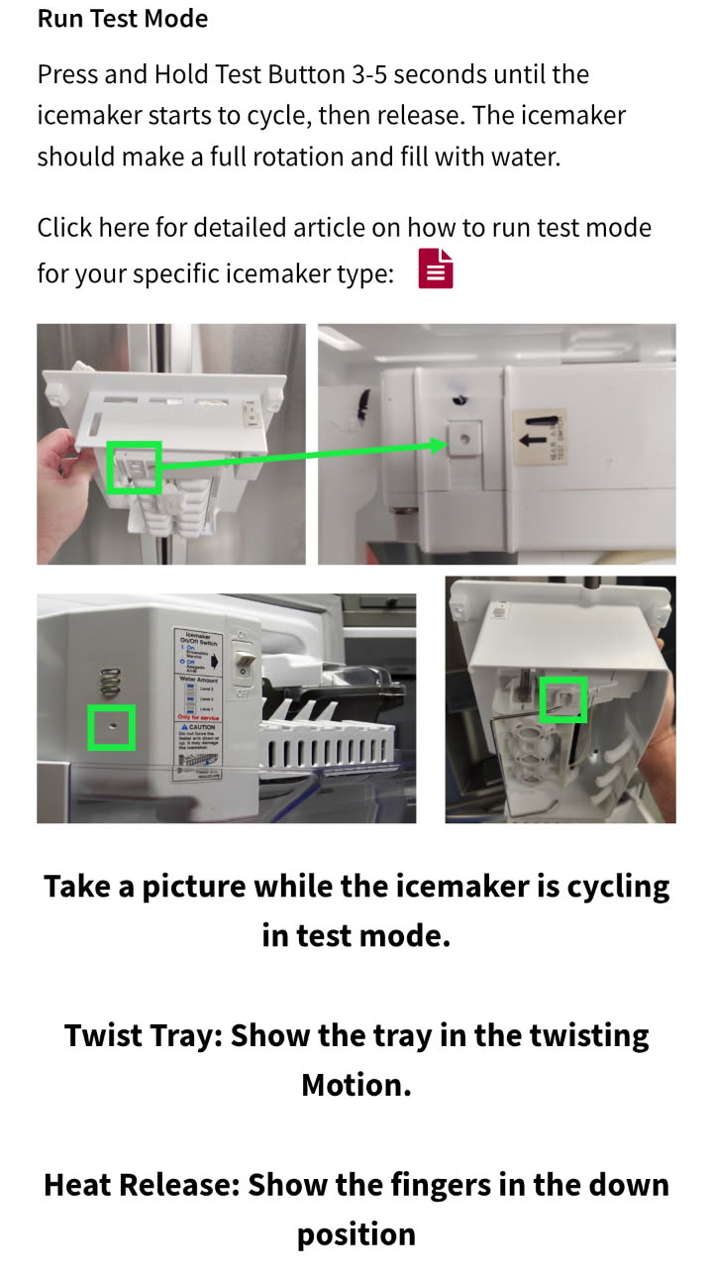
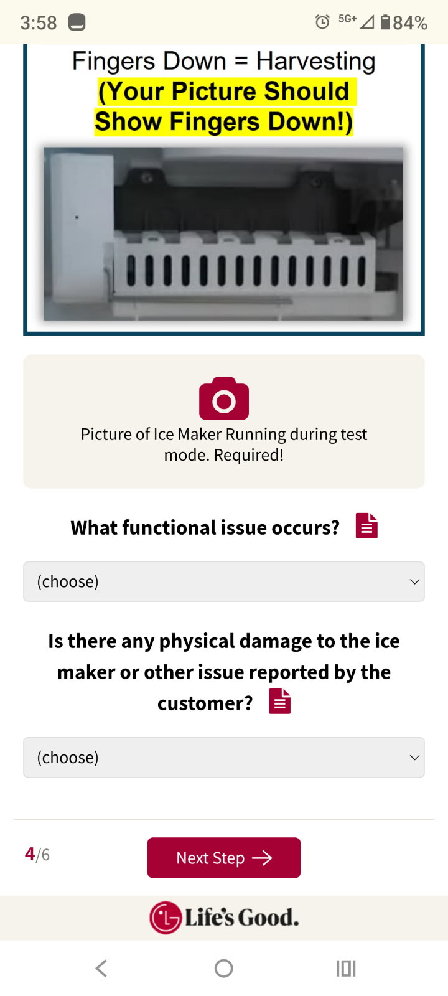
Step 4: Ice & Water Troubleshooting
No Ice Checklist Update – August 2025
Step 4:
Technician will need to…
Make sure the Icemaker is powered on, either with physical button or at display depending on Model.
Make sure the ice bin/bucket is installed properly.
Place the Icemaker into Test Mode.
Take a Picture showing that the Icemaker is running in Test mode. (Examples of picture required are shown here and in the App).
Select the Appropriate answers in the dropdowns at the bottom of Step 4.
What are the reviewers looking for?
That the tech took a proper picture showing the Icemaker running in test mode.
That the proper answers were selected at the bottom of the Step 4 page.
Note: If the Icemaker will not run test mode at all, make sure and capture a picture of the icemaker anyways. Then choose the appropriate answer from the dropdowns at the bottom of Step 4. (See next slide for example of Dropdown Answers).

Slide 6
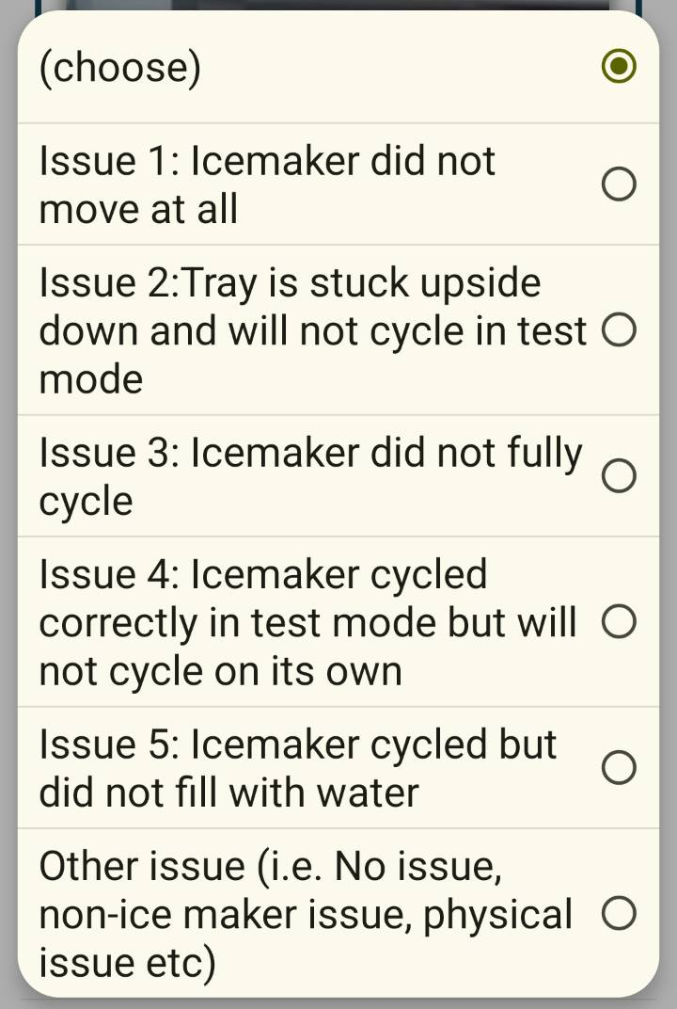
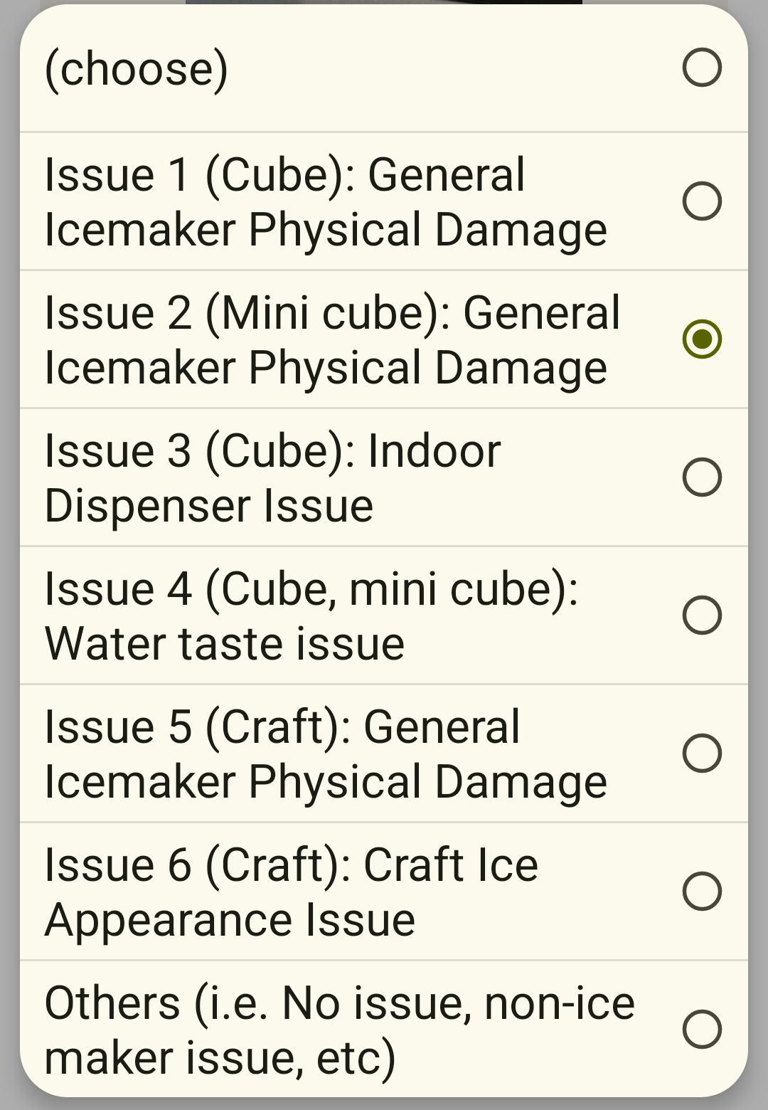
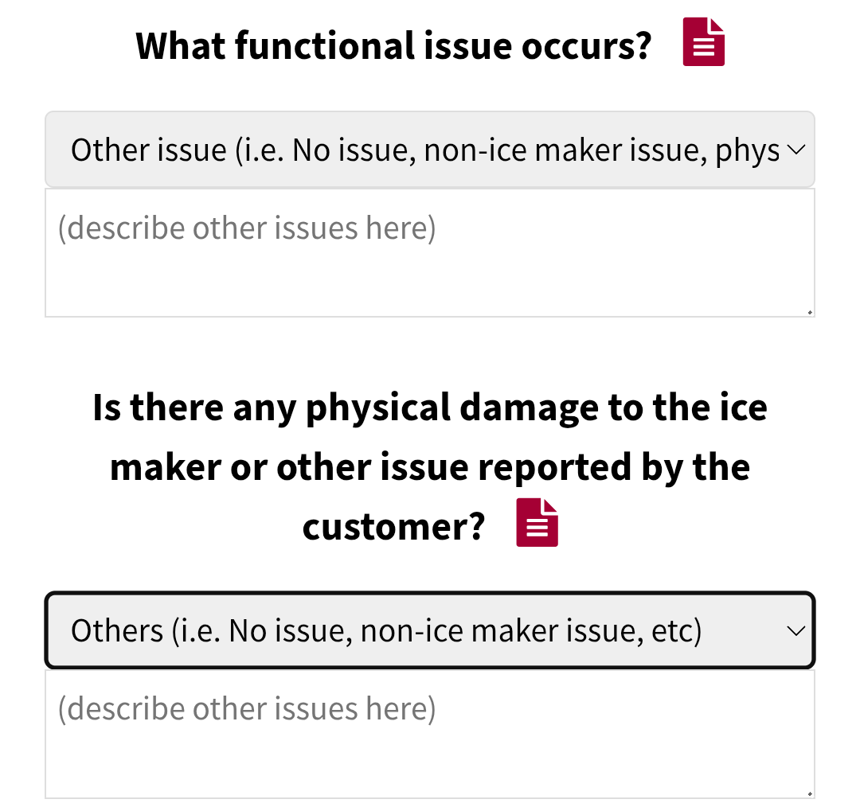
Step 4: Ice & Water Troubleshooting
No Ice Checklist Update – August 2025
Step 4 (Continued):
This is an example of the answers the technician can choose from at the bottom of Step 4:
Note: If the technician selects “Other Issue” a comment box will appear, and tech will need to give good detailed notes about what occurred.

Slide 7
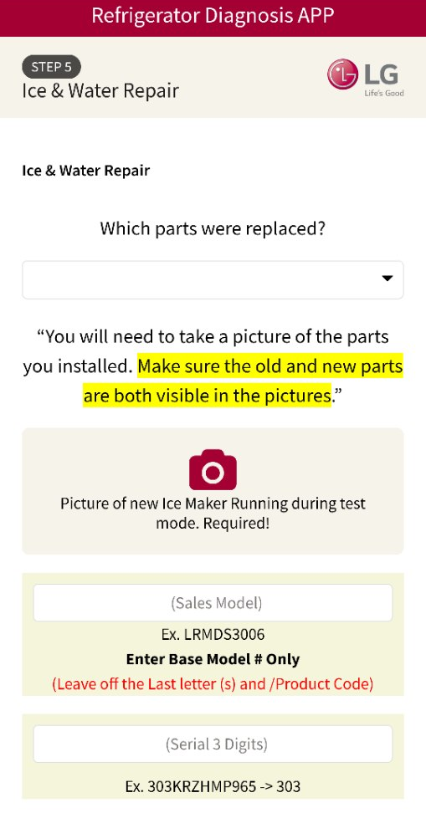
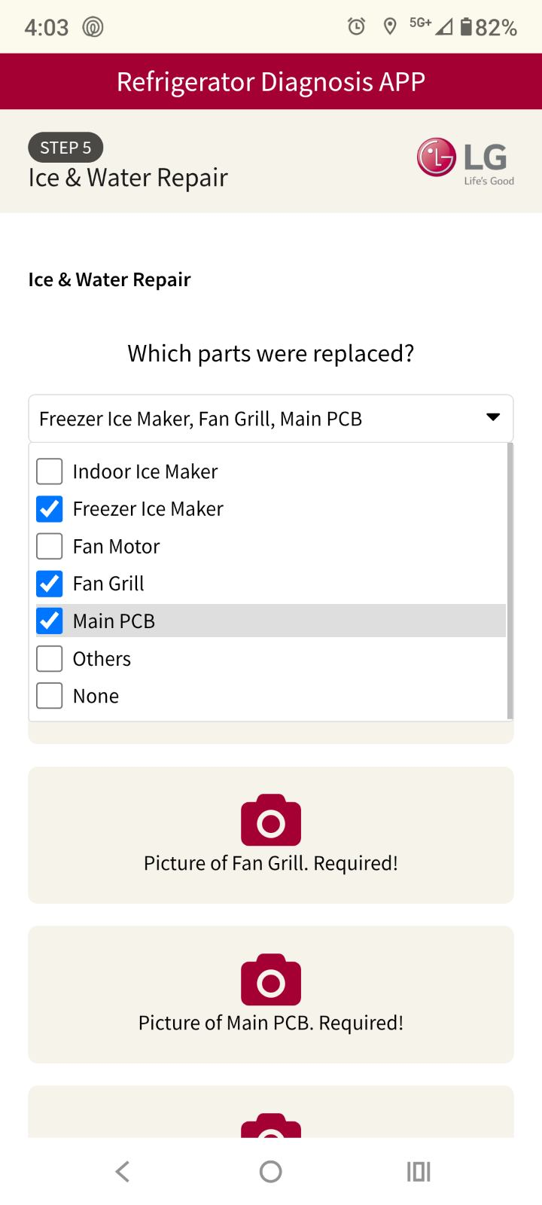
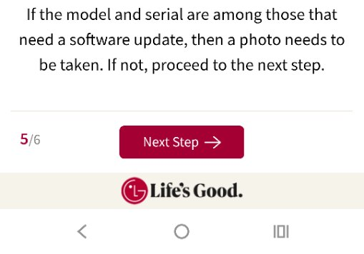
Step 5: Ice & Water Repair
No Ice Checklist Update – August 2025
Step 5:
Technician will need to…
Select all the parts they are replacing from the dropdown. (Make sure the parts selected match any parts that were recommended during the troubleshooting process).
Provide a picture of the new part(s) installed. (The old and new part will need to be visible in the picture).
If an icemaker was installed will need to show a picture of it running in test mode after being replaced.
Enter Model/Serial to check for Craft Icemaker Software Update.
If Software Update was needed, provide a picture showing the SW Update was completed.
What are the reviewers looking for?
That parts selected match what is used in the RNN/No Ice Troubleshooting.
That pictures of parts are entered correctly.
That picture of new icemaker running test mode is entered.
That the Model/Serial# entered by the technician matches the Model/Serial in the RNN#.
That proper picture showing Software Update Completed is entered if required.
Note: Reviewer will check the RNN so make sure you select all parts you replace and take pictures!

Slide 8
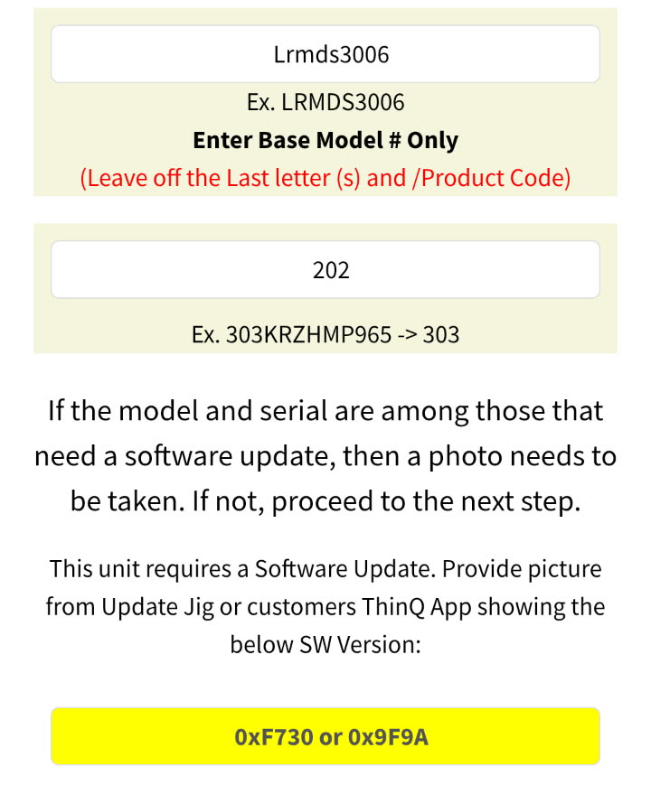
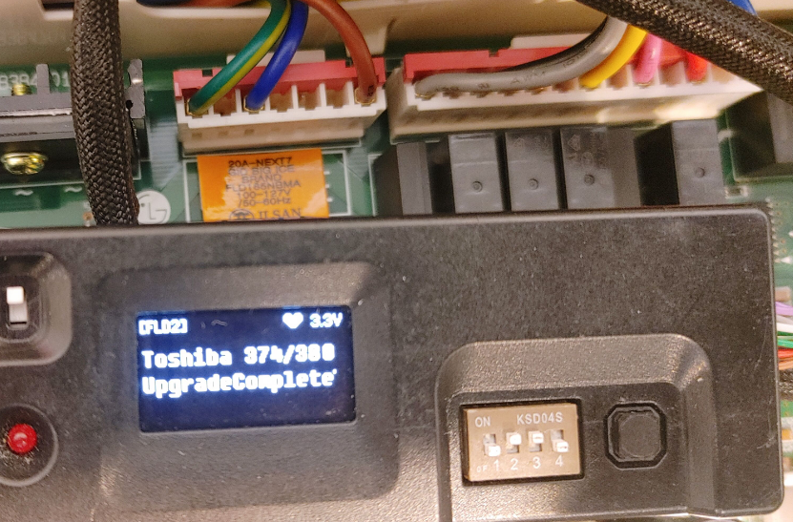
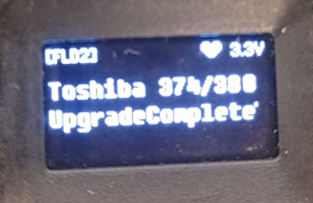
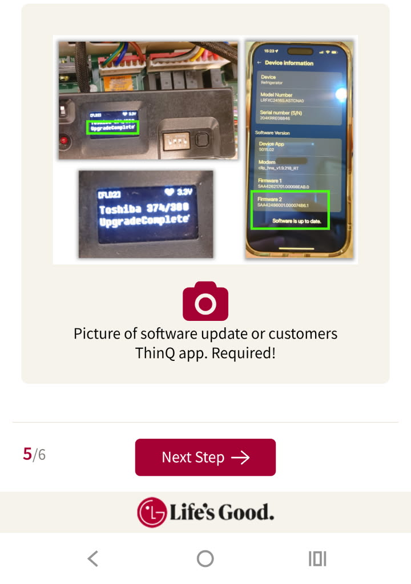
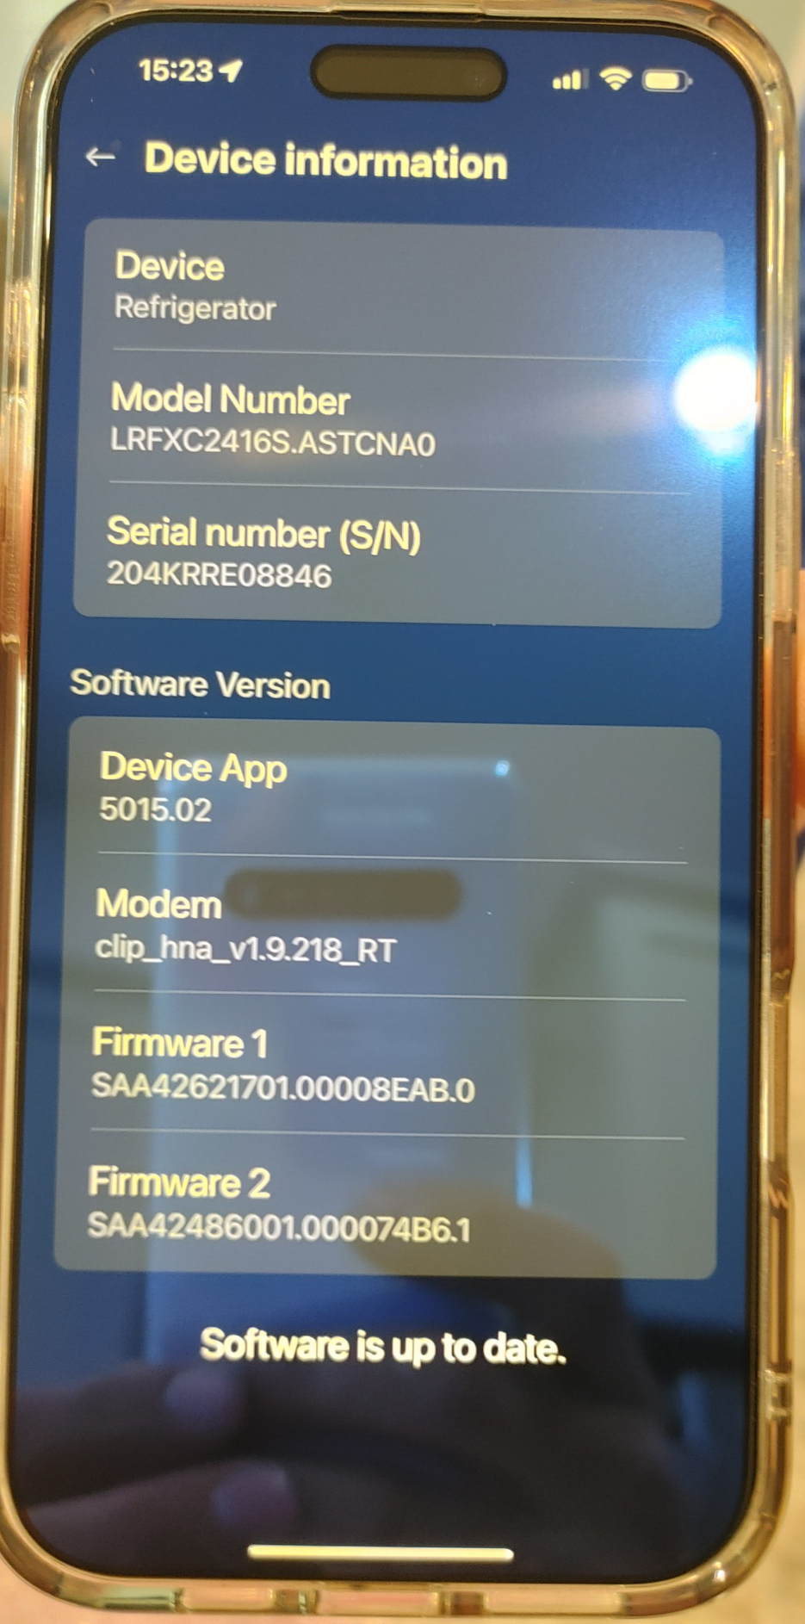
Step 5: Ice & Water Repair
No Ice Checklist Update – August 2025
Step 5 (Continued):
Enter the Model/Serial in the formats exactly like the examples given.
Slow down and make sure you type the Model/Serial accurately! We have seen many typing mistakes in the past!
If Software Update is required a yellow box with the new software version will appear.
Make sure the picture of your jig shows “Upgrade Complete” as shown in the example picture. Or that the Customer’s ThinQ App shows that “Software is Up to Date”
Note: If the Craft Ice Software is updated through ThinQ make sure and snap a picture from the customers phone for proof.
Note: Firmware 2 inside the ThinQ App is for the Craft Icemaker Software.

Slide 9
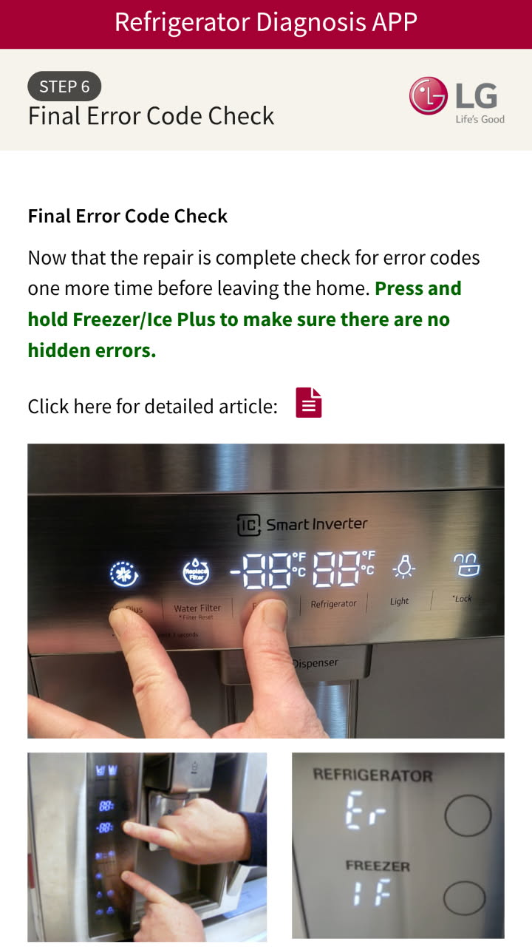
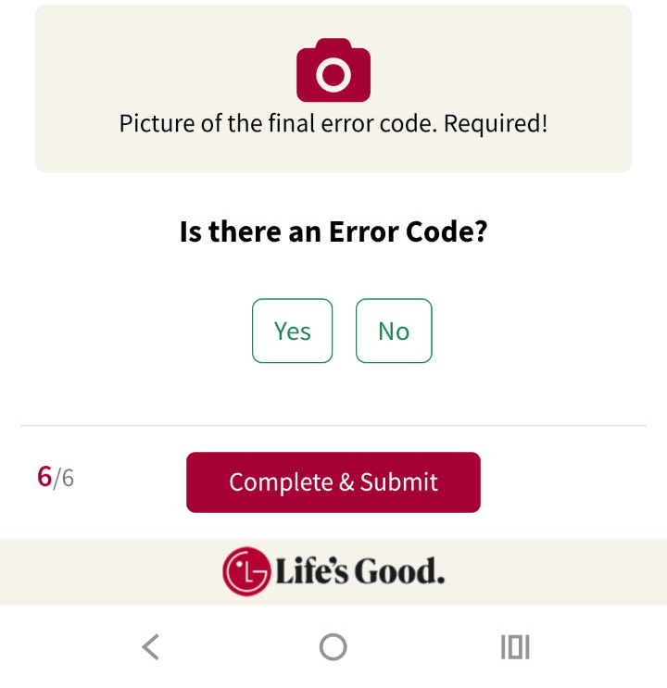
Step 6: Final Error Code Check
No Ice Checklist Update – August 2025
Step 6:
Technician will need to…
Check for error codes displayed. If no error code is displayed, check for hidden error codes.
Take a picture that clearly shows the display.
Answer the question, “Is there an Error Code?” If so, select the error code from the list that will appear.
What are the reviewers looking for?
That the proper picture of display was taken.
That the tech selected the error code appropriately.
Note: If the unit does not have a digital display where error codes can be checked, simply take a picture of the controls. Or if the buttons are too far apart to reach and take a picture at the same time, take a picture attempting to press the buttons.

