Slide 1
The next Slides will show all the required pictures to be able to submit a
“No Cell Service Checklist” for No Cool.
Note: These are the same pictures required by the normal checklist except for the screenshot showing cell service level…
Screenshot showing Cell Service Level/Date/Time
Initial Error Code Check Picture
Initial Machine Room Picture
Diagnosis Jig Result or Pressure Readings
Flushing Setup
Parts Replaced
Micron Levels
Final Error Code Check
If Technicians reclaim is over 10%, Will also be required to show…
Drier Contents
Contamination Check
150PSI Nitrogen Check
Bubble Checks

Slide 2
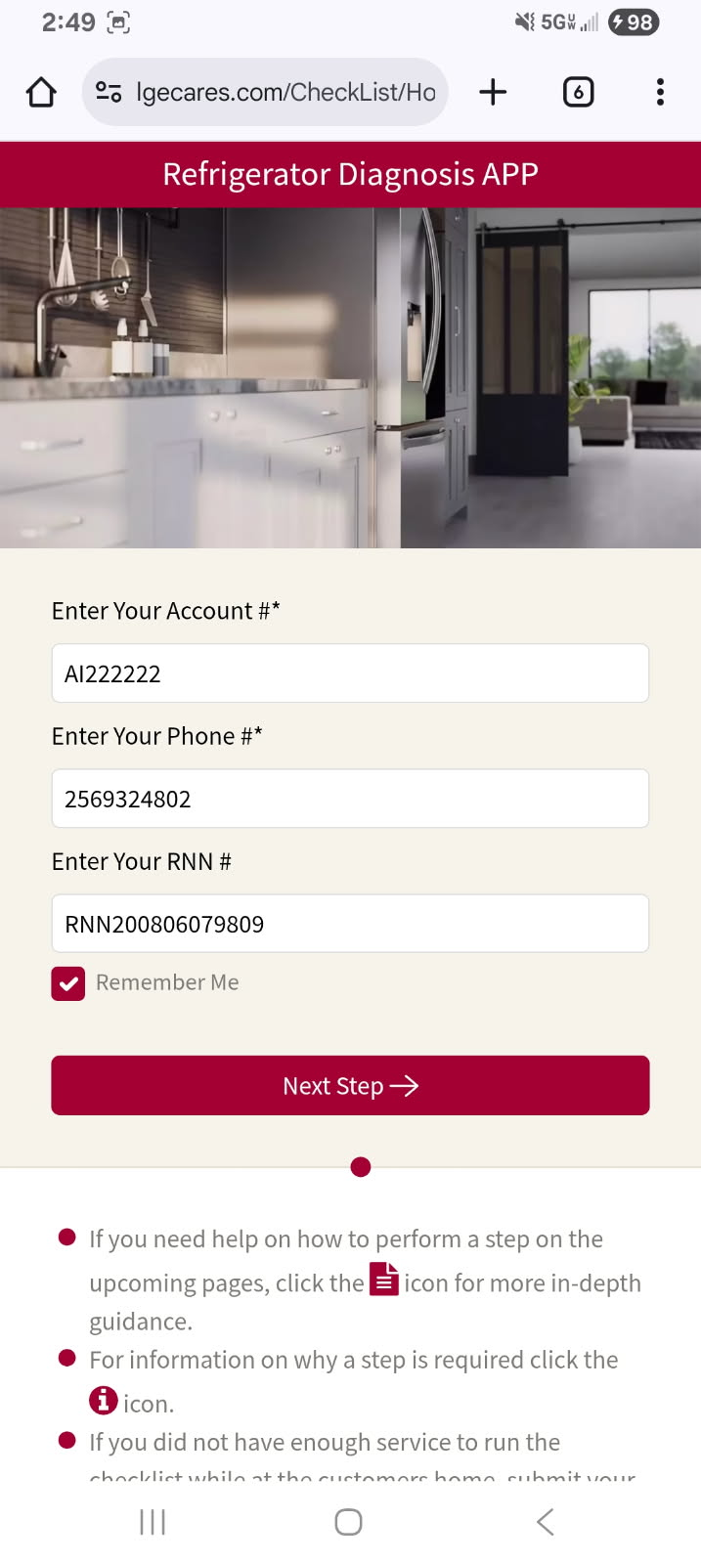
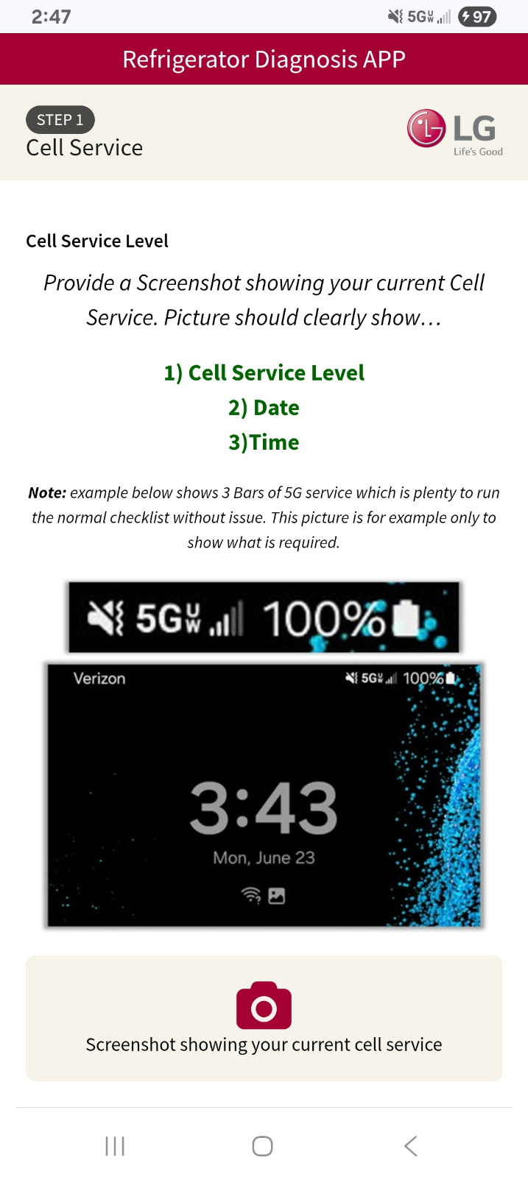

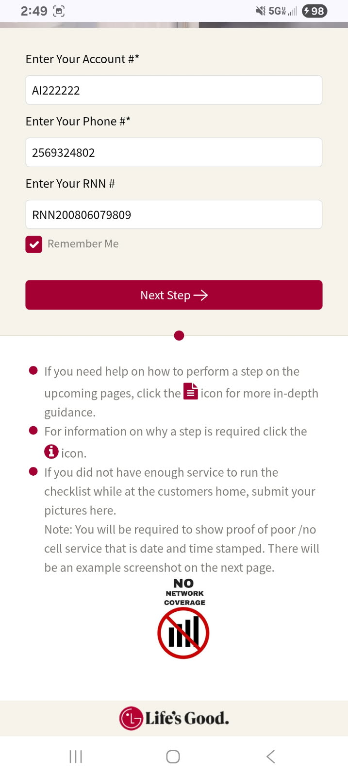
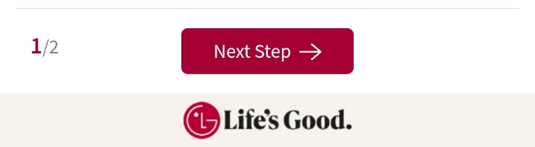
“No Network Coverage” option has been added to the Checklist Login Screen for No Cool / No ice Cases.
This option is only to be used in the case the technician does not have enough cell service for the checklist to work.
Technician will be required to take a screenshot showing the Cell Service level at the customers home and will need to be time/date stamped like the example shown here.
Technician will still need to gather all the required pictures that would be submitted to the normal checklist and will be able to UPLOAD all the pictures later when they have cell service again.
Failure to provide all required pictures will result in a “Bad” checklist review.

Slide 3

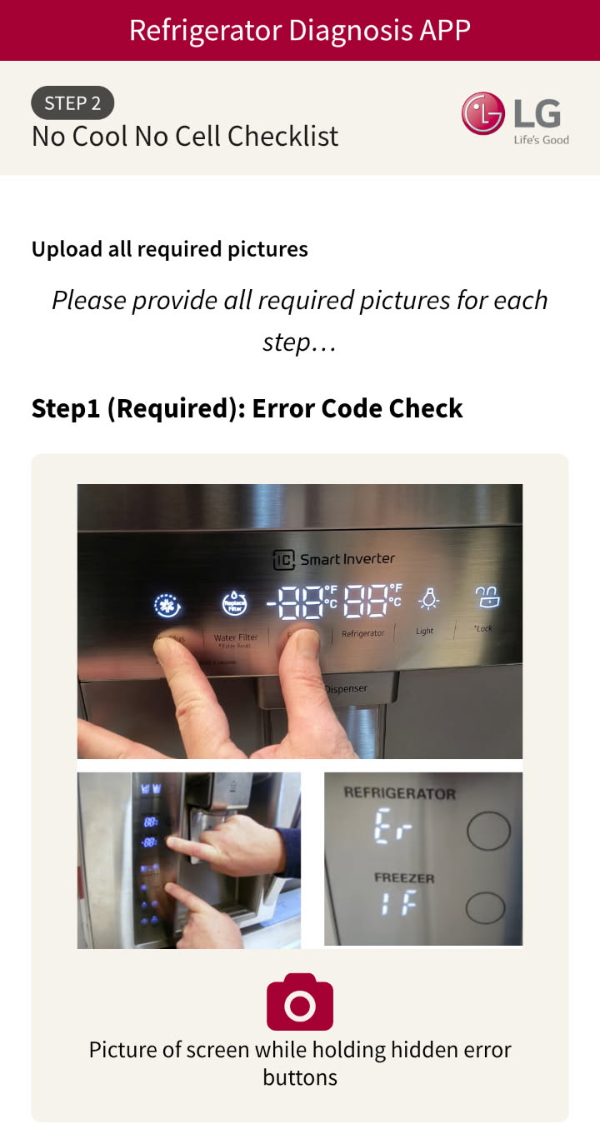
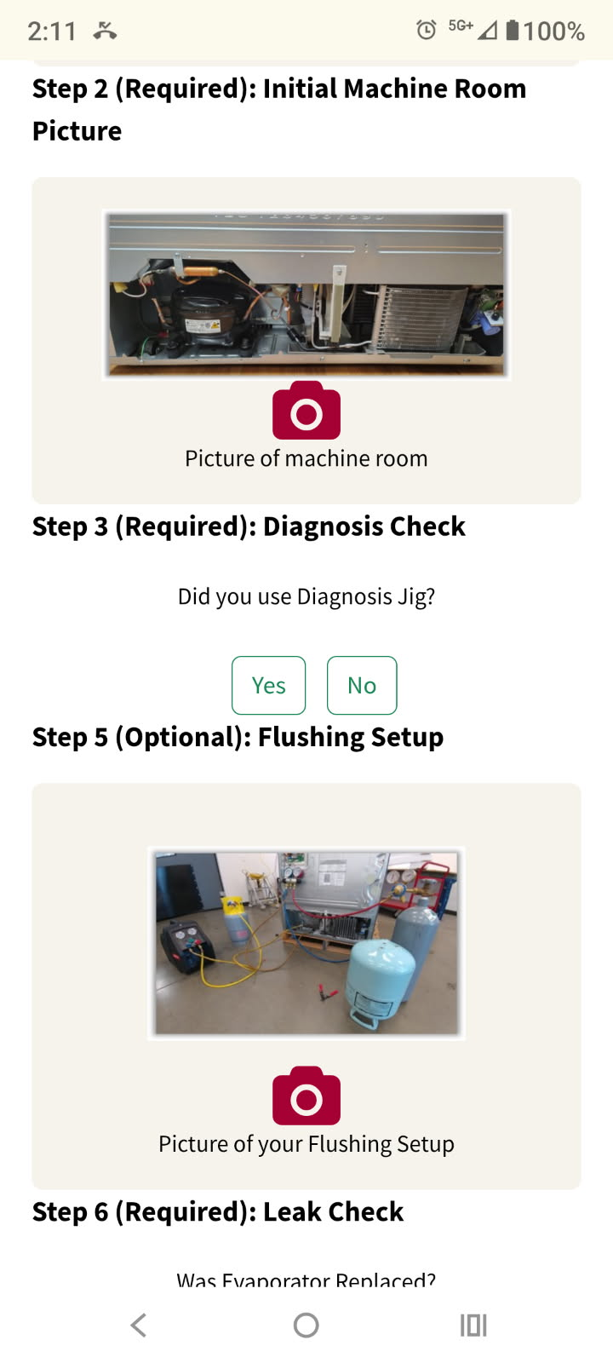
No Cell Service Option – No Cool
Required Picture #2:
Technician will need to upload a picture showing the whole machine room before they begin the repair.
Required Picture #1:
Technician will need to upload a picture showing they performed the Error Code Check on the customers unit.

Slide 4
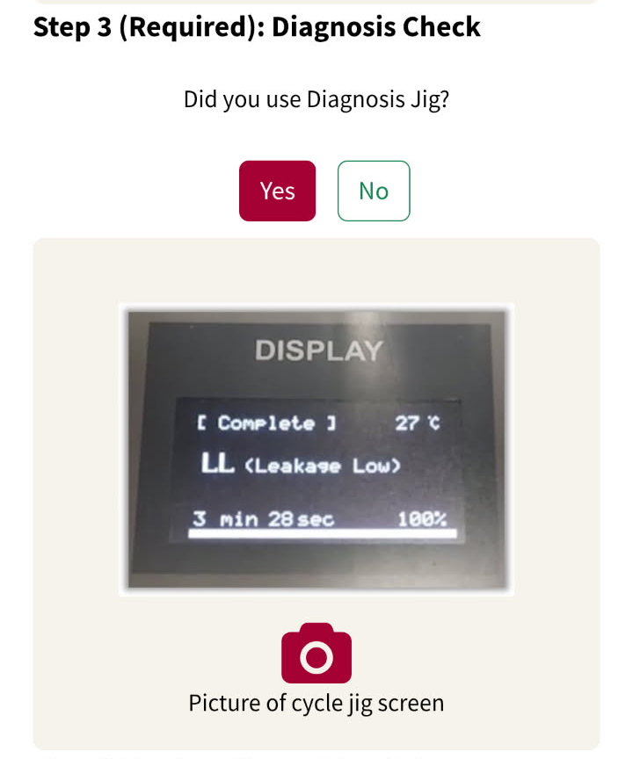
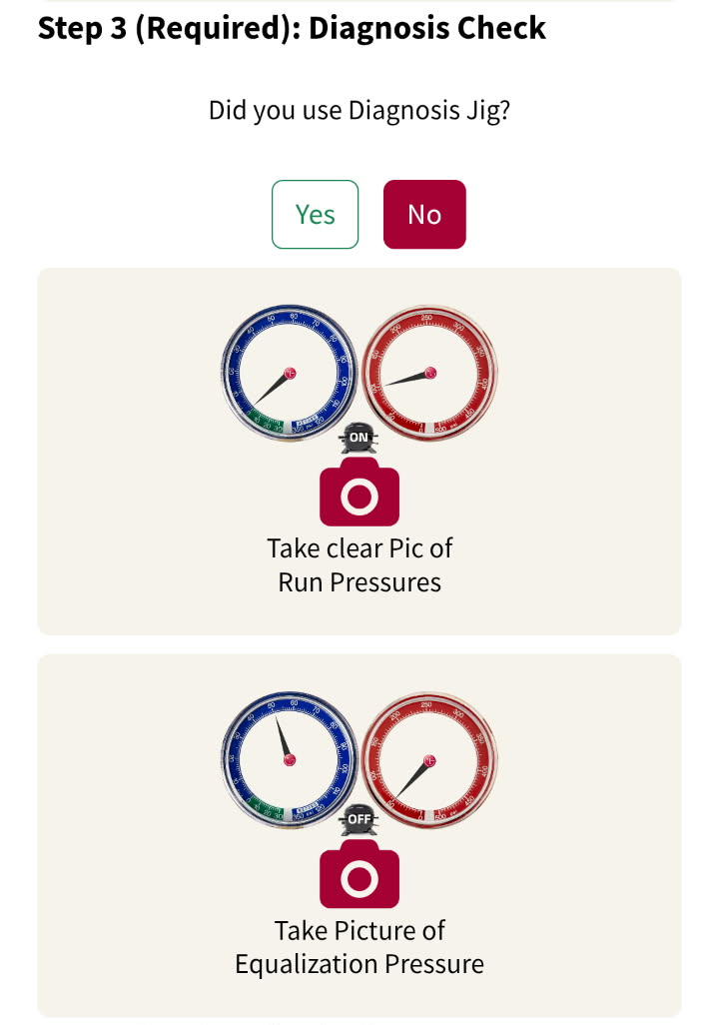
No Cell Service Option – No Cool
Required Picture(s) #3:
1) If tech used the Diagnosis Jig, Select “Yes” and Upload 1 picture that clearly shows the diagnosis result
2) If tech did not use the Diagnosis Jig, will need to upload Run Pressure Pic and Equalization Pressure Pic.

Slide 5
No Cell Service Option – No Cool
If the technician flushed the sealed system, please provide picture of the flushing setup.

Slide 6
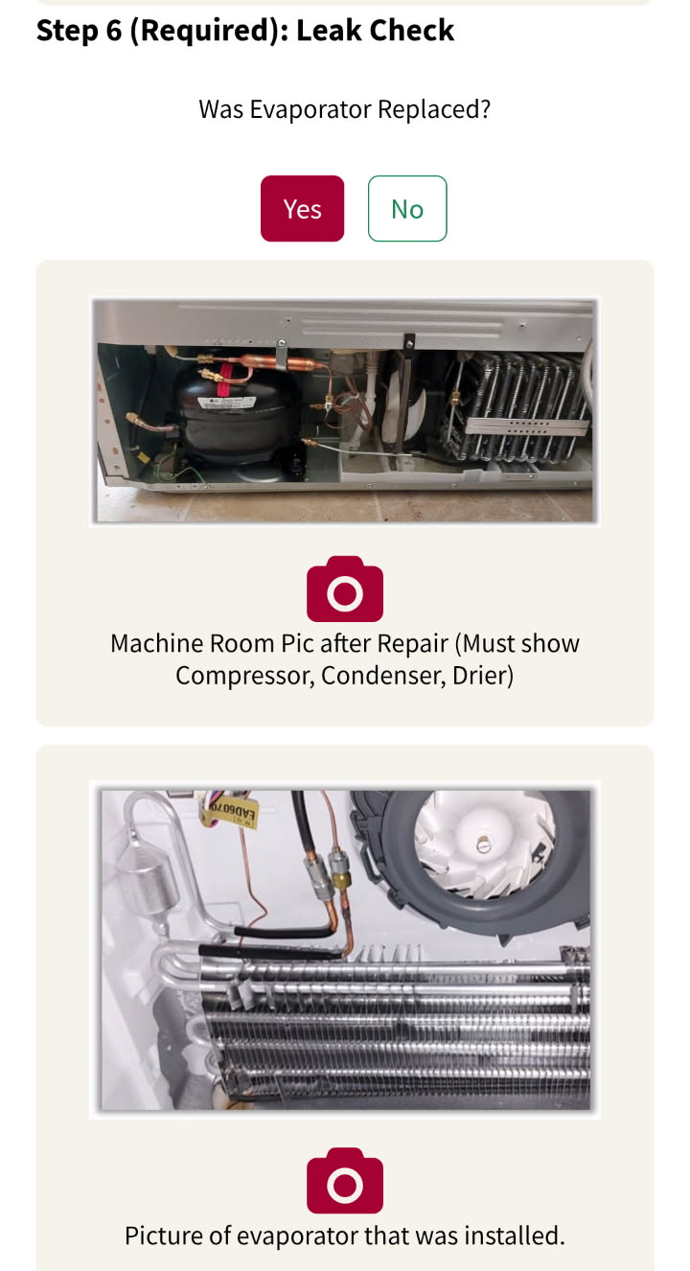
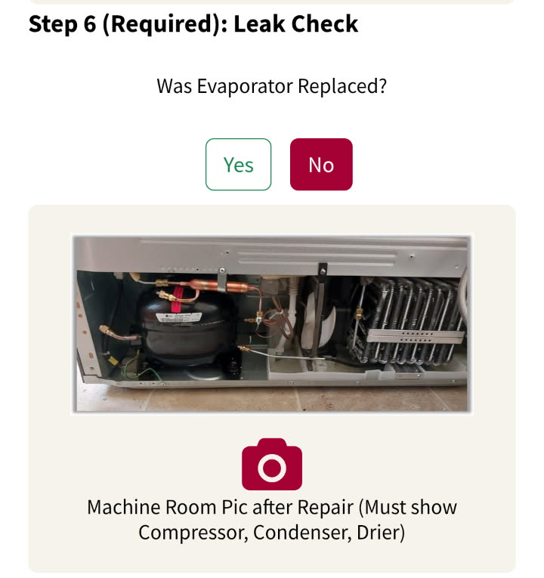
No Cell Service Option – No Cool
Required Picture(s) #4:
1) If evaporator was replaced… Provide picture of the Evaporator that was installed and the Machine Room.
2) If evaporator was not replaced…
Provide a picture of the Machine Room.

Slide 7
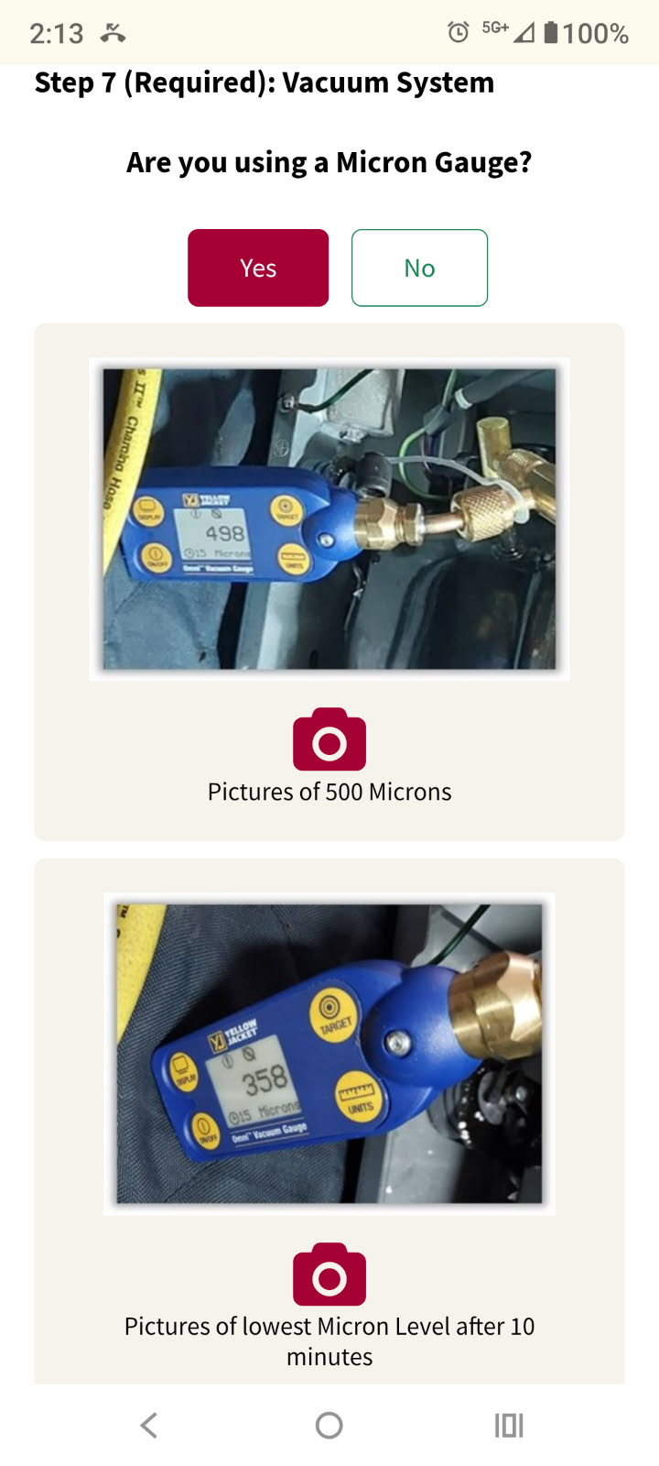
No Cell Service Option – No Cool
Required Pictures #5:
1) DMST Will answer “Yes”. Then provide a picture where they achieved 500 Microns or Less
2) Then provide a picture of the Micron Level after the pump ran an additional 10 minutes.

Slide 8
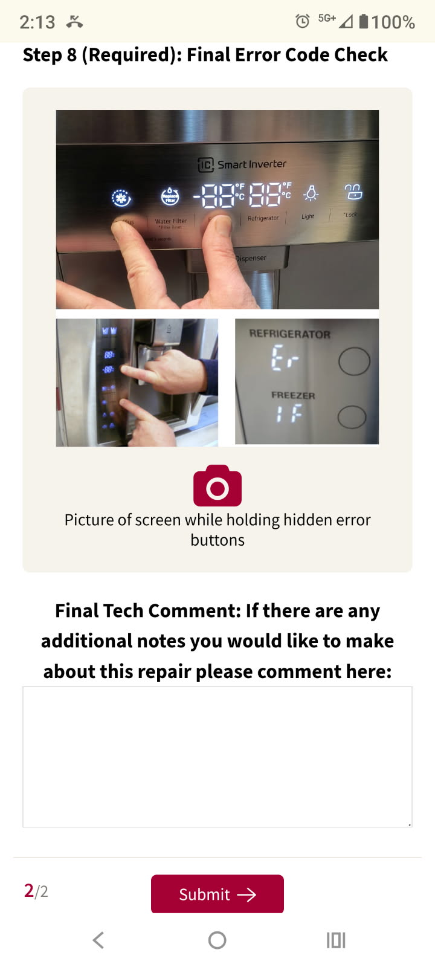
No Cell Service Option – No Cool
Required Picture #6: Provide a picture of the final Error Code Check.
Note: There is a comment section at the end where the technician can freely make notes and comments.

Slide 9
Techs can also use this option for No Ice cases as well. They will just need to upload all the pictures that are currently required by the checklist.
Screenshot showing Cell Service Level/Date/Time
Initial Error Code Check Picture
Temperature Checks
Software Update Pics for Craft Icemaker
Damage to Icemaker

