Slide 1

Pg.1
No Cool Checklist Update - November 2025
Updated No Cool Checklist (Effective Monday November 3, 2025)
Main Changes:
New Step 1: Temperature Check
Previously Step1 was Error Code Check, but has changed to Temperature Check.
Step 2: Error Code Check and Blink Code Check Combined
Error Code Check and Blink Code Check have been combined into one step.
The option to select “Non-Sealed” issue was moved to the end of Step 2.
If the issue is sealed system related, the initial machine room picture will still be required at the end of Step2.
Step 3 / Diagnosis: No change from current checklist.
Step 4: High Side Contamination Check and RX-11 Flushing Combined
Currently Step4 is cutting drier open and checking for contamination with nitrogen and Step5 is RX-11 Flushing. These steps are now combined as one step.
5) New Step 5: Low Side Contamination Check
Techs will be asked to check for contamination/blockages in the low side of the system using nitrogen.
This will require flowing nitrogen from the capillary tube through the low side of the system.
Step 6: Leak Check
The only change to this step is relocating the final machine room picture.
Final Machine Room Picture has been moved from Step 6 to Step 8.
If issue was evaporator related the pictures of the installed evaporator will still be taken here in Step6.
Step 7 / Vacuum: No Change from current checklist
Step 8 / Final Operation Checks: Additional Items Added
Final Machine Room Picture moved to Step 8. (Techs need to take this picture right before installing the machine room cover to show the full repair in the machine room area).
Added Fan Operation Check.
Added Icemaker Test Mode Check.

Slide 2
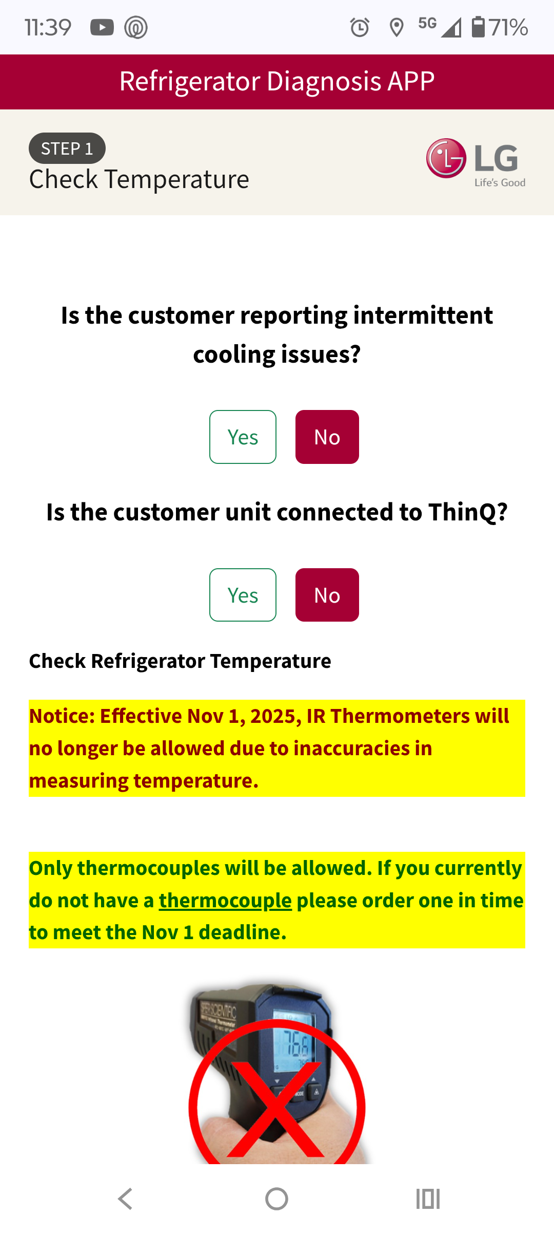
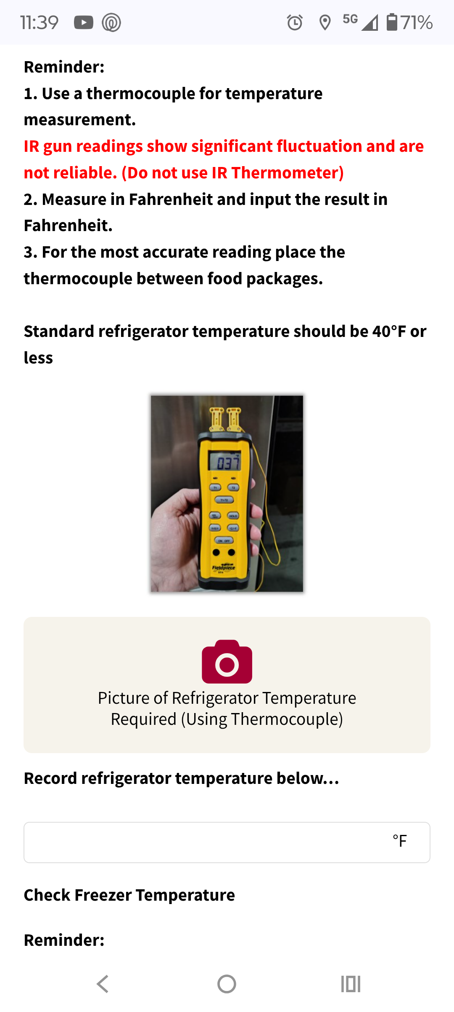
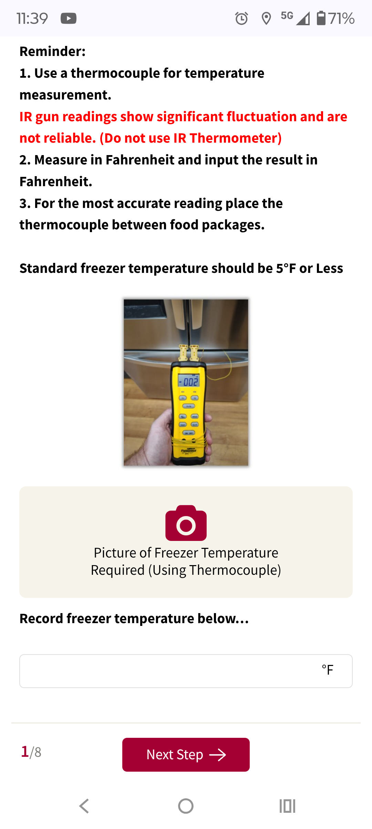
Pg.2
No Cool Checklist Update - November 2025
*NEW* Step 1 Temperature Check (If Customer is not connected to ThinQ)
Techs will need to answer questions about intermittent cooling.
Based on the answers the tech will be asked if the unit is connected to ThinQ. If not…
Tech will be prompted to check temperatures in the refrigerator and freezer sections.
Will need to use a thermocouple for these readings. Temp guns will not be allowed after Nov 1, 2025.
Will be required to enter temperatures and take pictures of thermocouple reading.

Slide 3
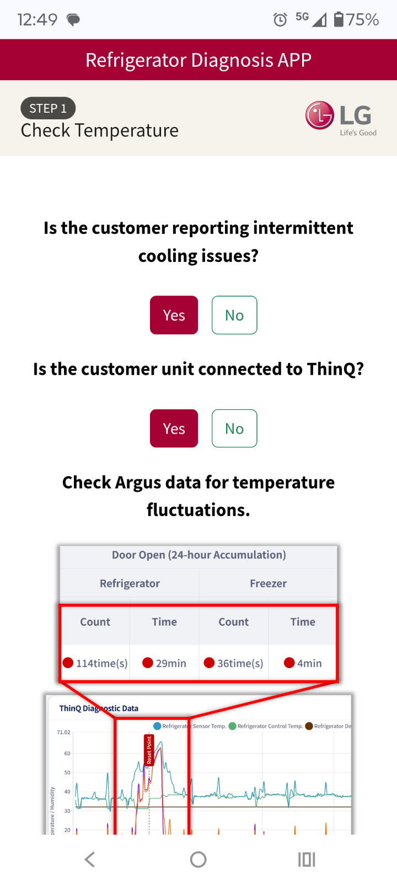
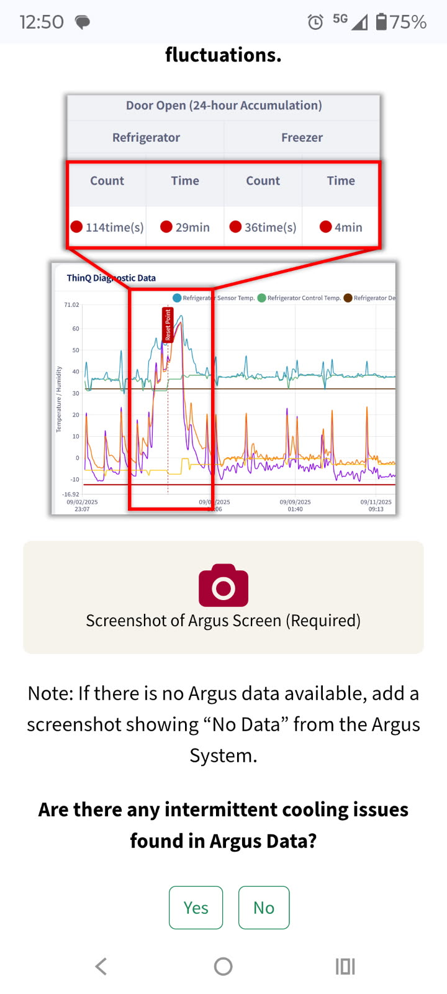
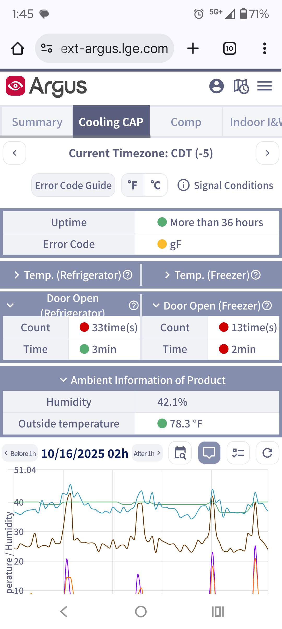
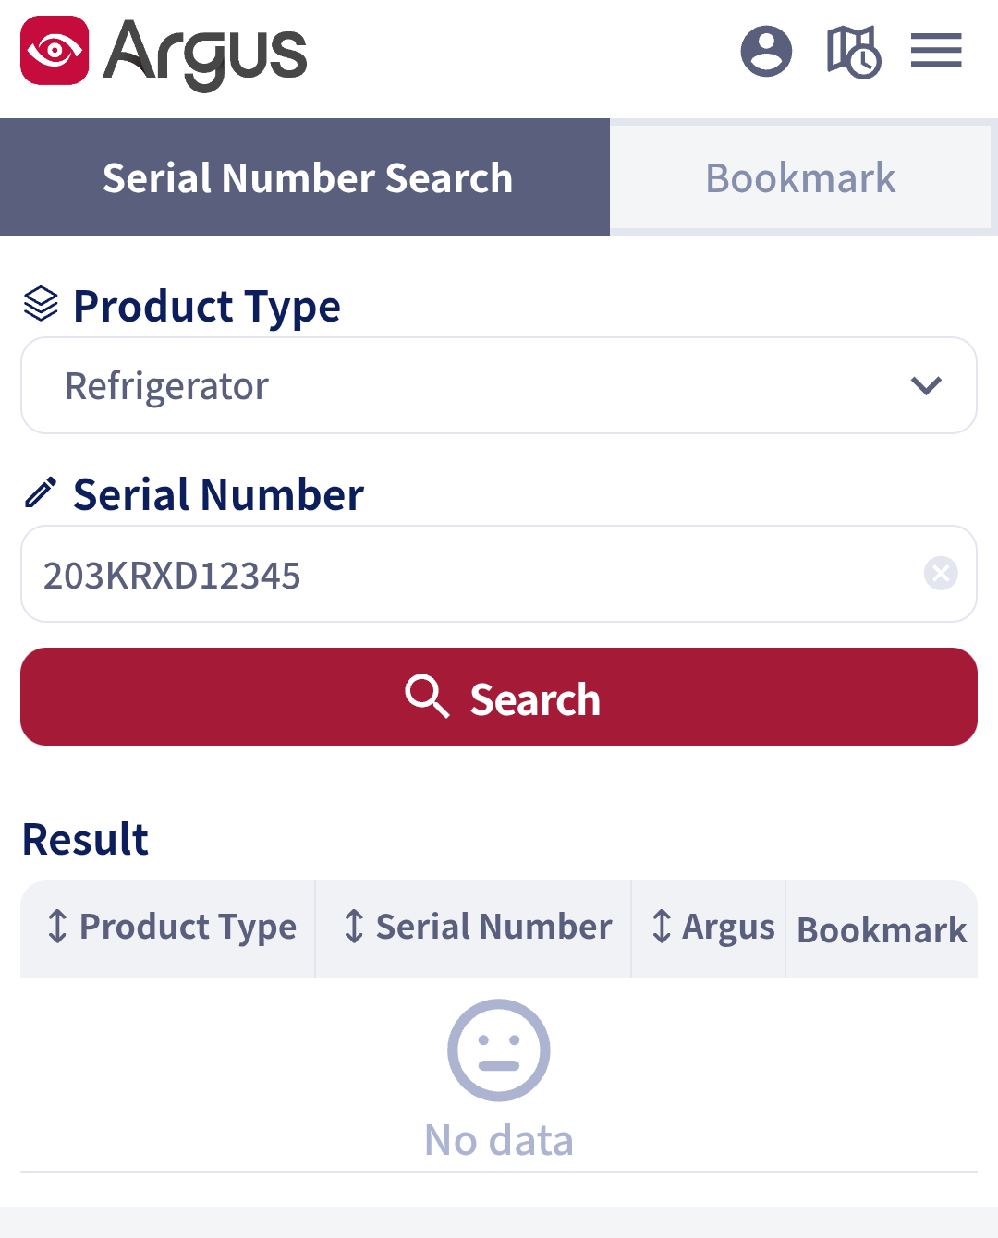
Pg.3
No Cool Checklist Update - November 2025
*NEW* Step 1 Temperature Check (If Customer is connected to ThinQ)
Techs will need to answer questions about intermittent cooling.
Based on the answers the tech will be asked if the unit is connected to ThinQ. If so…
Tech will be prompted to check Argus Data and attach a screenshot showing Argus usage.
Tech will also be prompted to check temperatures in the refrigerator and freezer sections like Slide 2.
Will need to use a thermocouple for these readings. Temp guns will not be allowed after Nov 1, 2025.
Will be required to enter temperatures and take pictures of thermocouple reading.

Slide 4
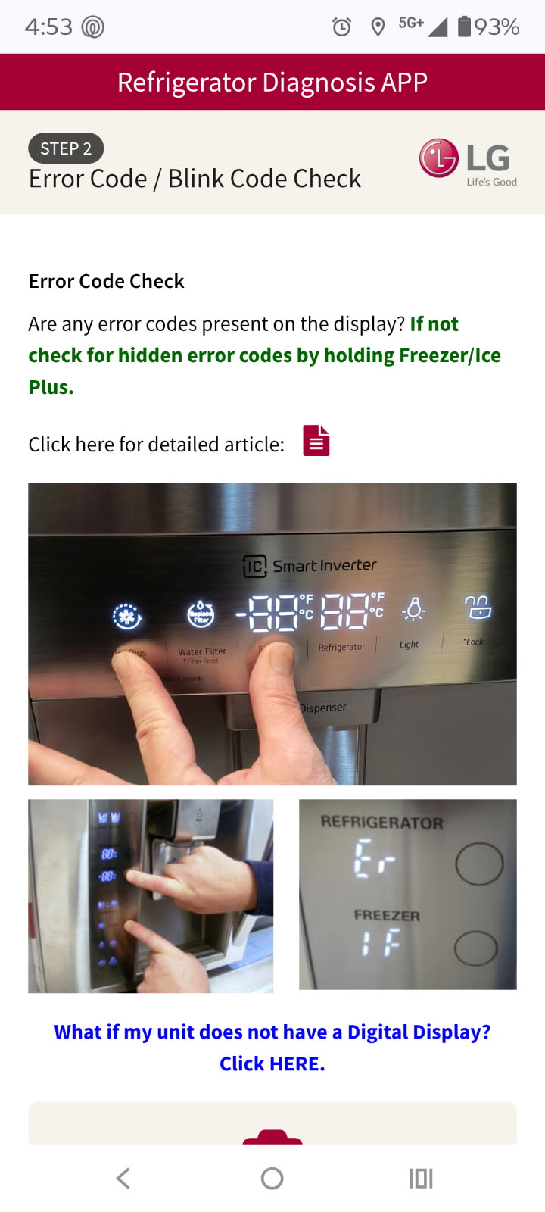
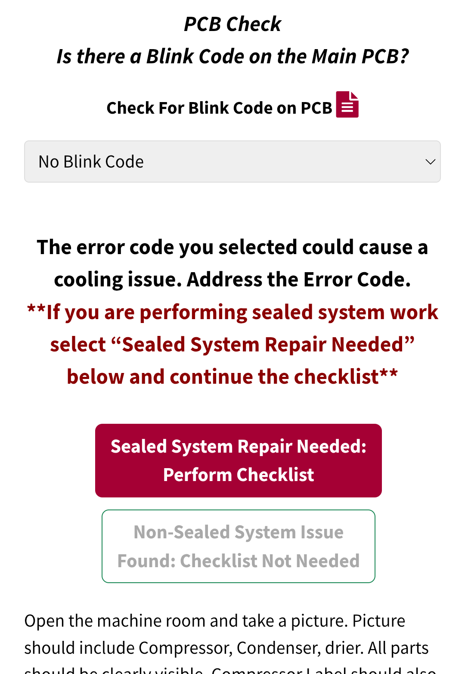
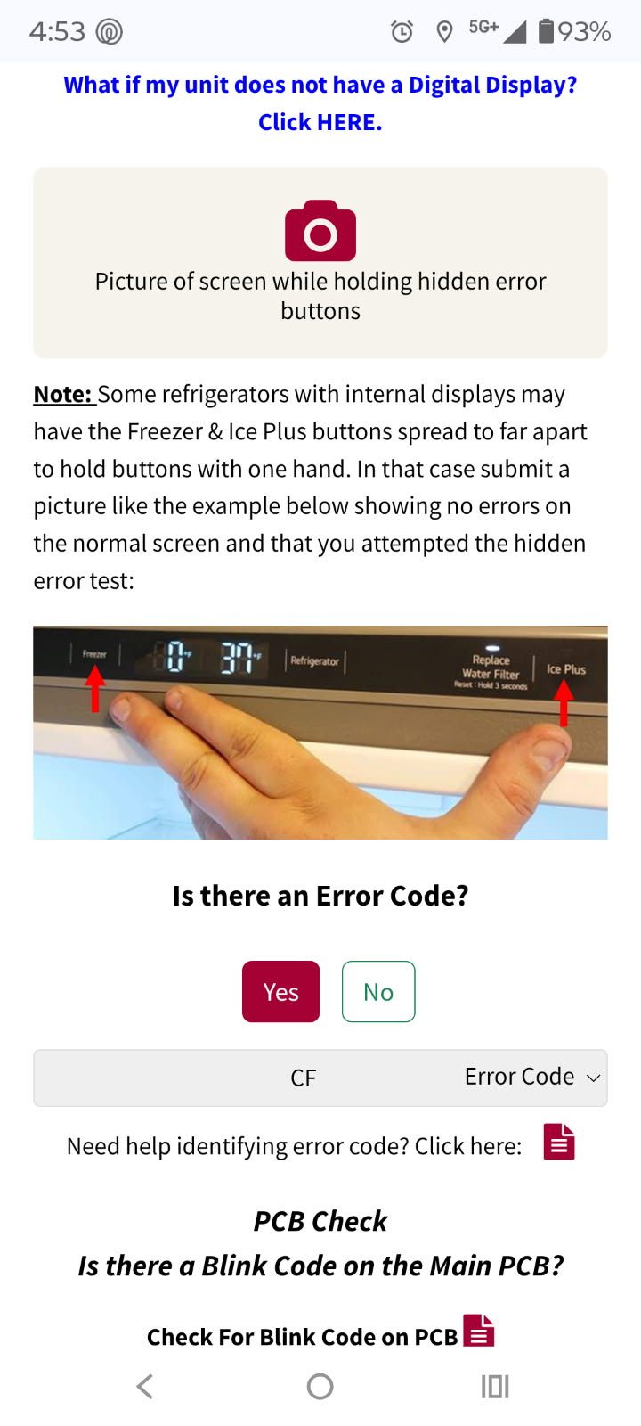
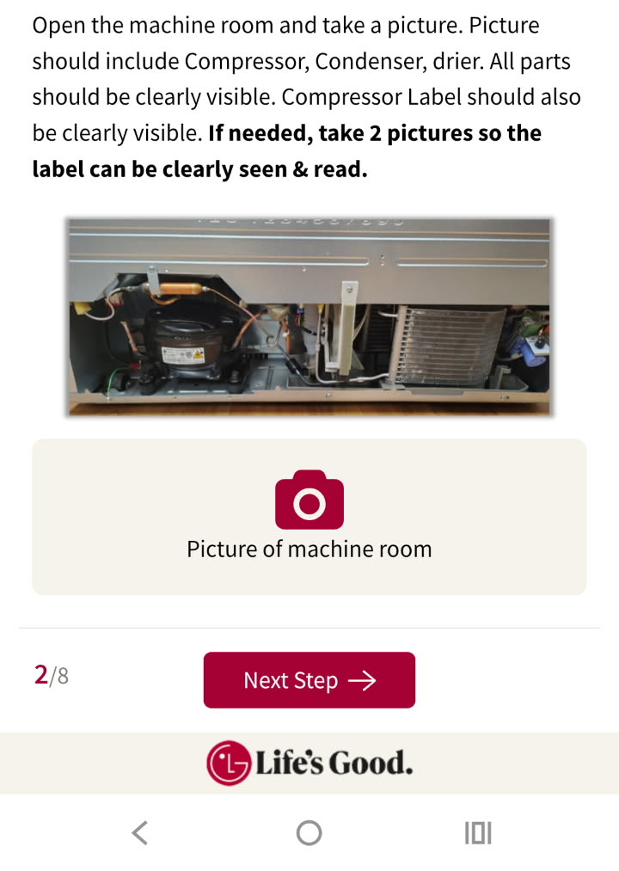
Pg.4
No Cool Checklist Update - November 2025
Step 2: Error Code / Blink Code Check
Error Code and Blink Code checks have now been combined into one step.
Techs will need check for Error Codes. If there is an error code present or hidden, select the error from the dropdown menu.
Tech will also need to check for blink codes at the Main PCB and select from the list.
Tech will be prompted to select if the unit has a Sealed System Issue or not. If so, tech will prompted to take the initial machine room picture and the checklist will continue as normal. If Not, The tech will need to fill out the Non-Sealed System information.
Note: The Non-Sealed option now has more requirements as shown on the next slide.
See Next Slide
Make sure when you take the machine room picture that the entire machine room is visible. Also, make sure the label can be clearly seen/read. If needed take two pictures to show a close up of the compressor label.

Slide 5
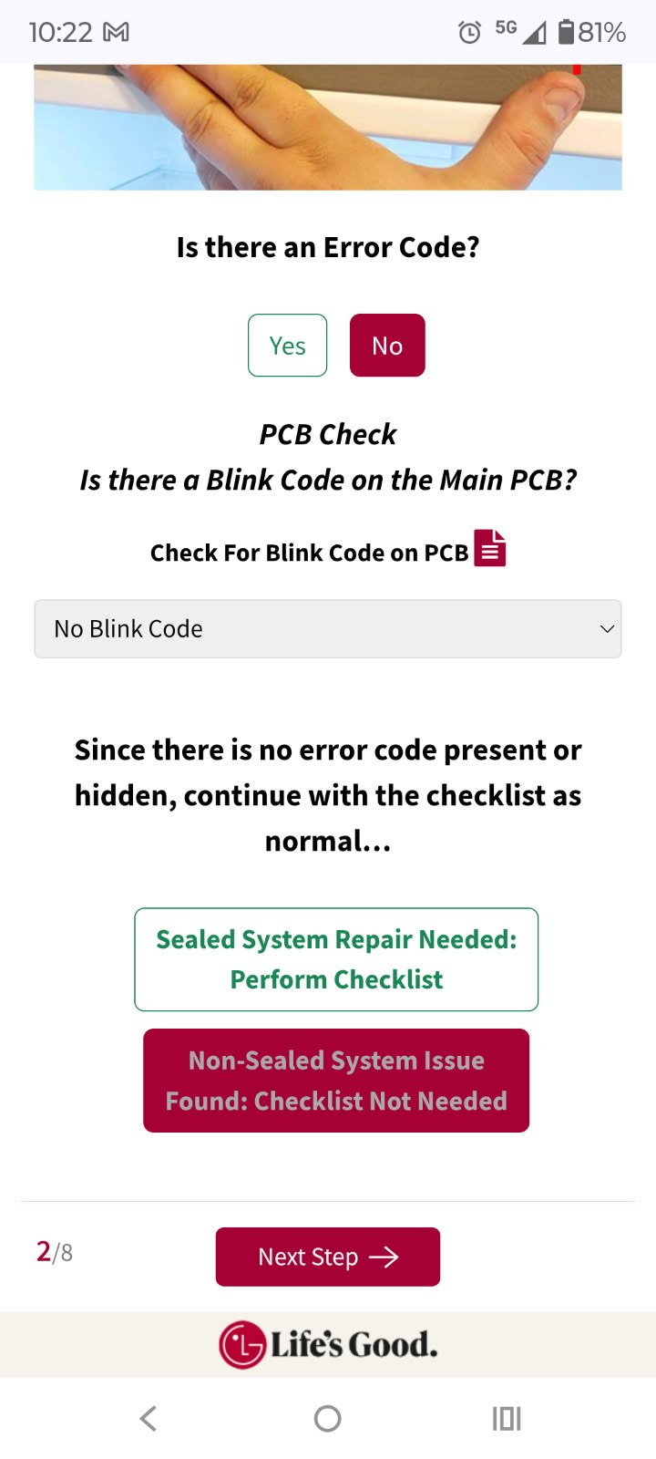
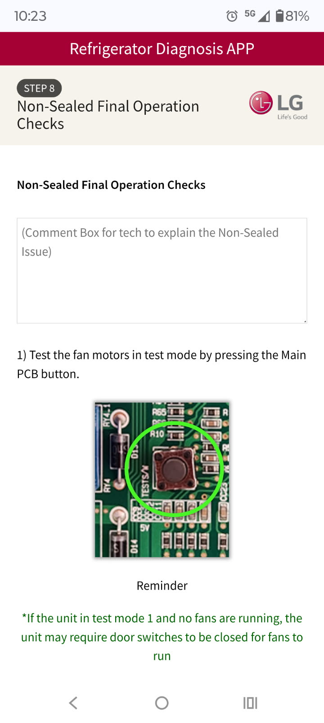
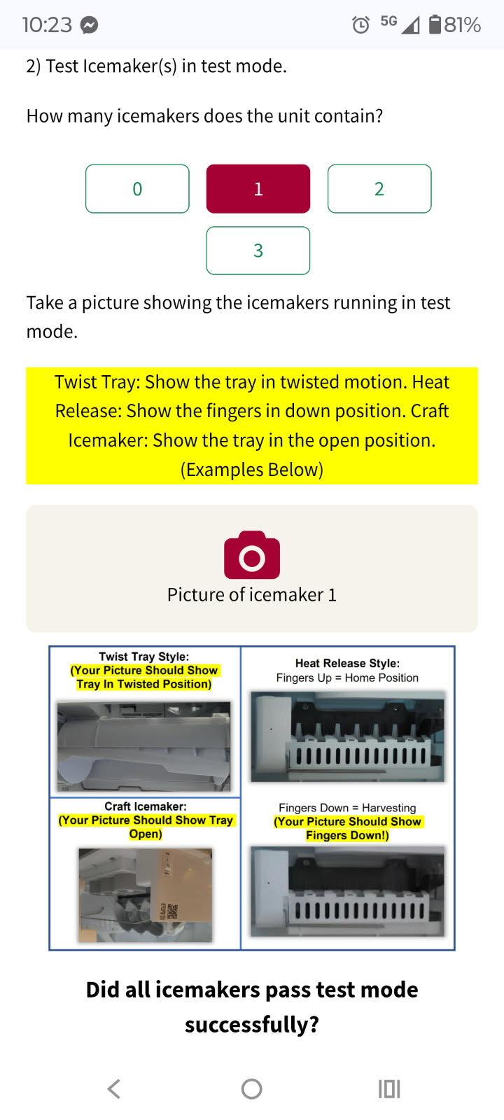
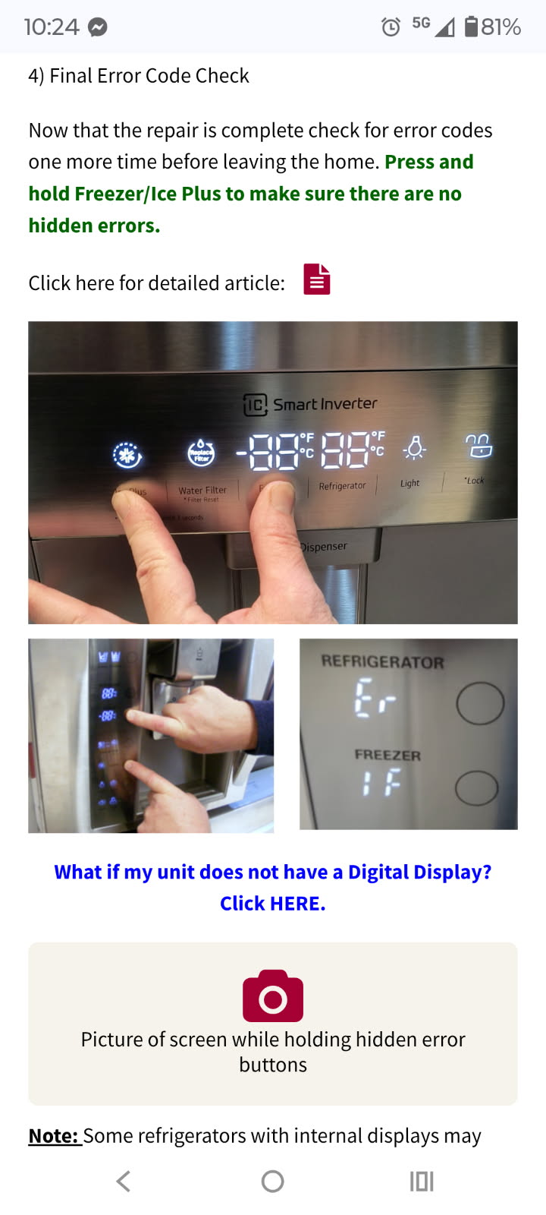
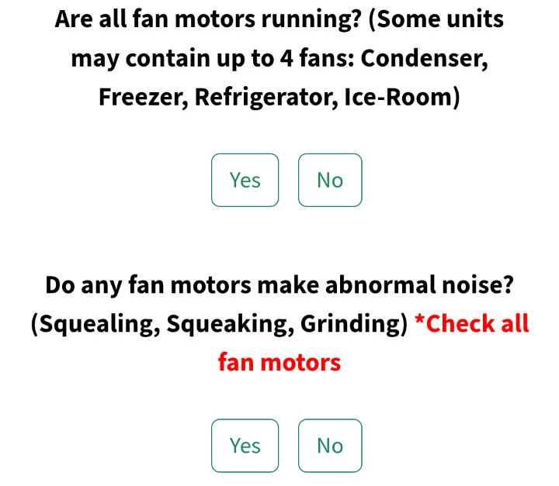
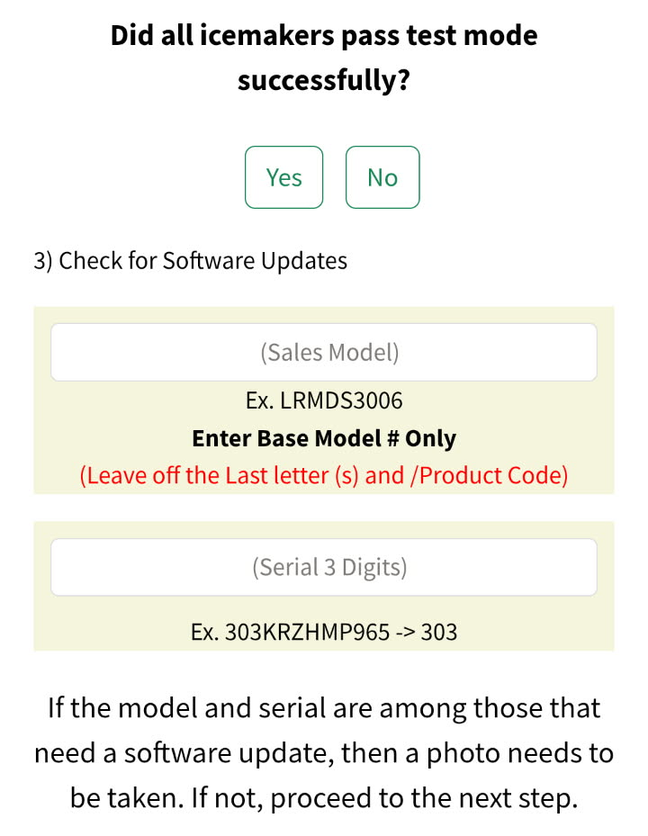
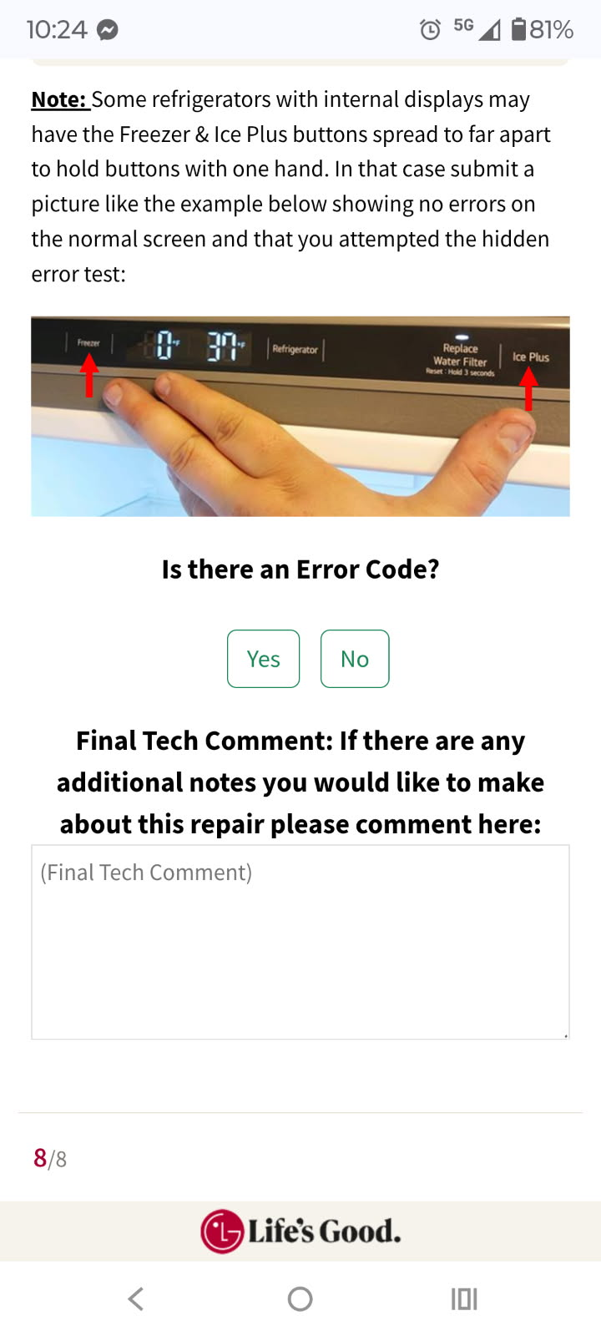
Pg.5
No Cool Checklist Update - November 2025
Non-Sealed System Option (If selected at Step 2)
If the tech selects Non-Sealed System Issue from Step 2, the flow is a little different than previous checklist versions.
Before, Tech would take the error code picture, leave a description of the non-sealed issue and optional pictures and submit the checklist.
With the newest version of the checklist, the tech will still need to leave a comment describing the non-sealed issue, but will also be required to make some final operation checks before leaving the home.
These final operation checks are important to make to help reduce reclaims for issues that could be overlooked by accident.
Non-Sealed Selected at Step 2
Tech will need to leave details of Non-Sealed Issue in the text box.
Then run test mode to check all fans for issues and answer two questions about fan operation
Next, select # of icemakers and take pictures of them running test mode.
Software Update Check may be added in the future.
Final Error Code Check is same as current checklist.

Slide 6
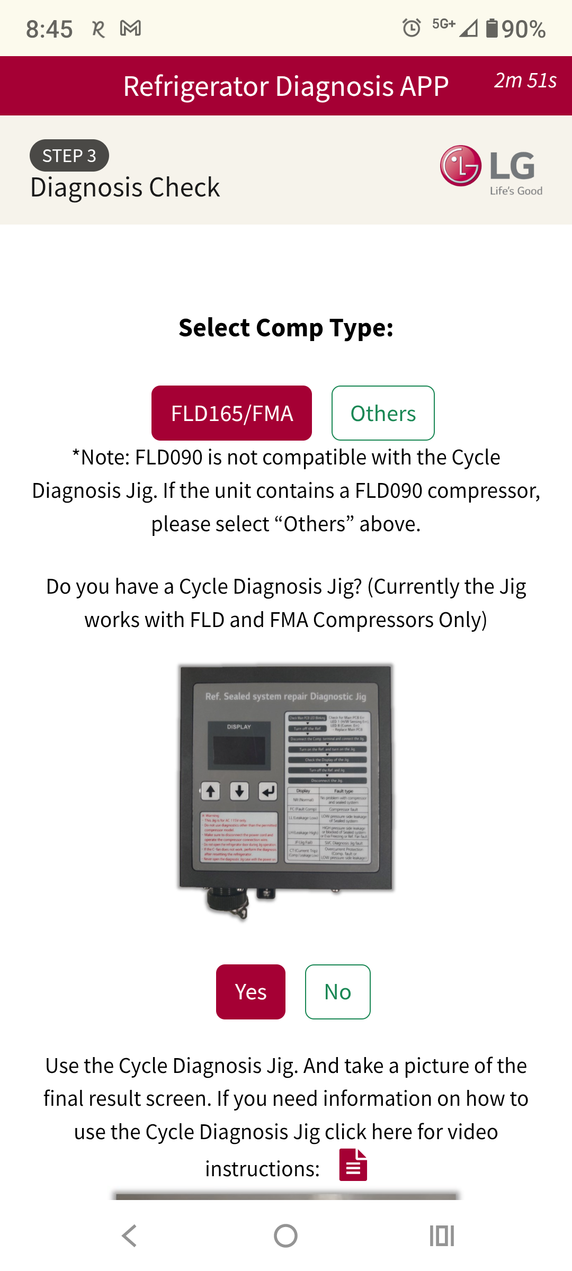
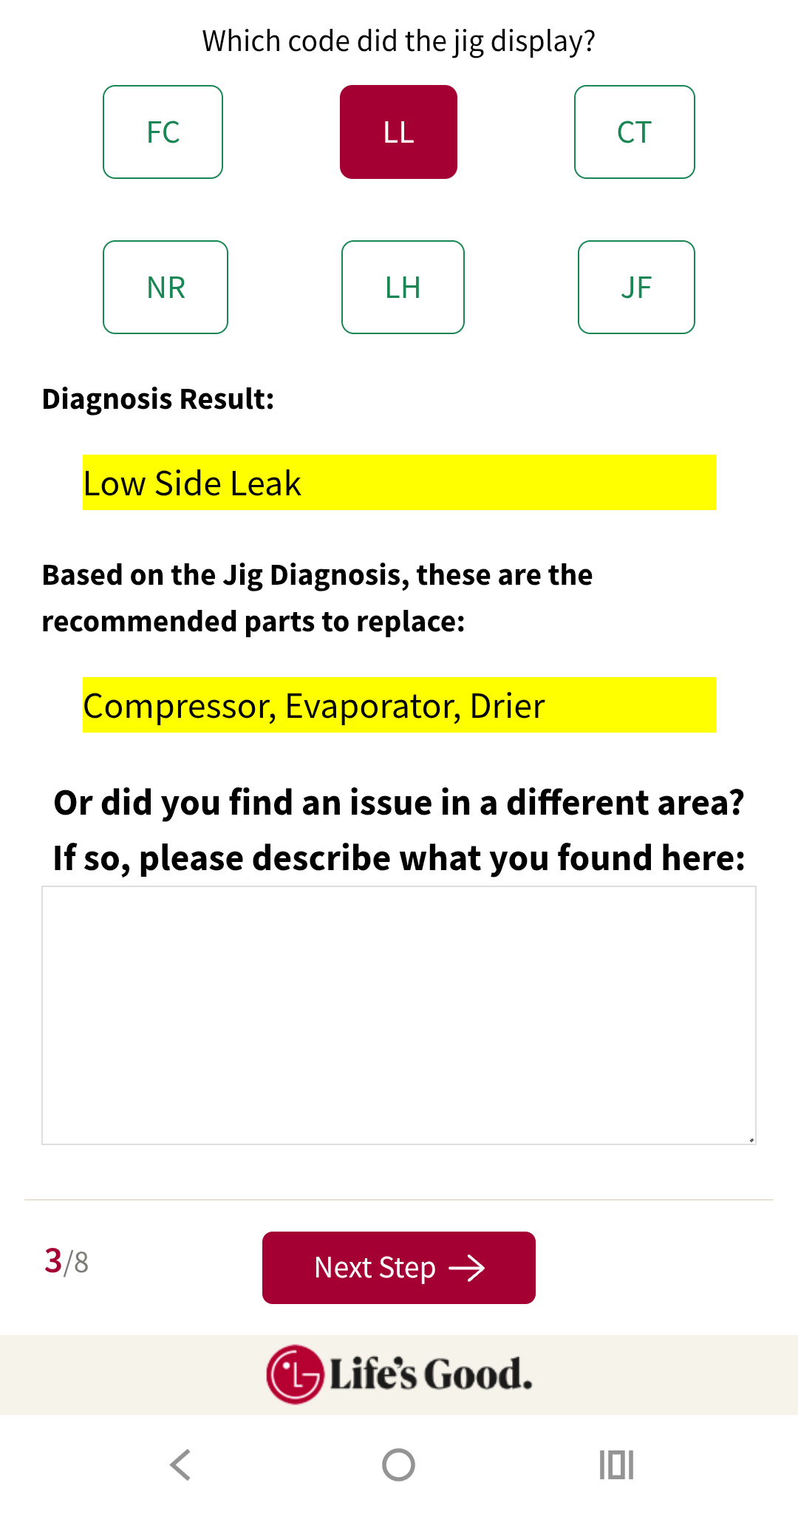
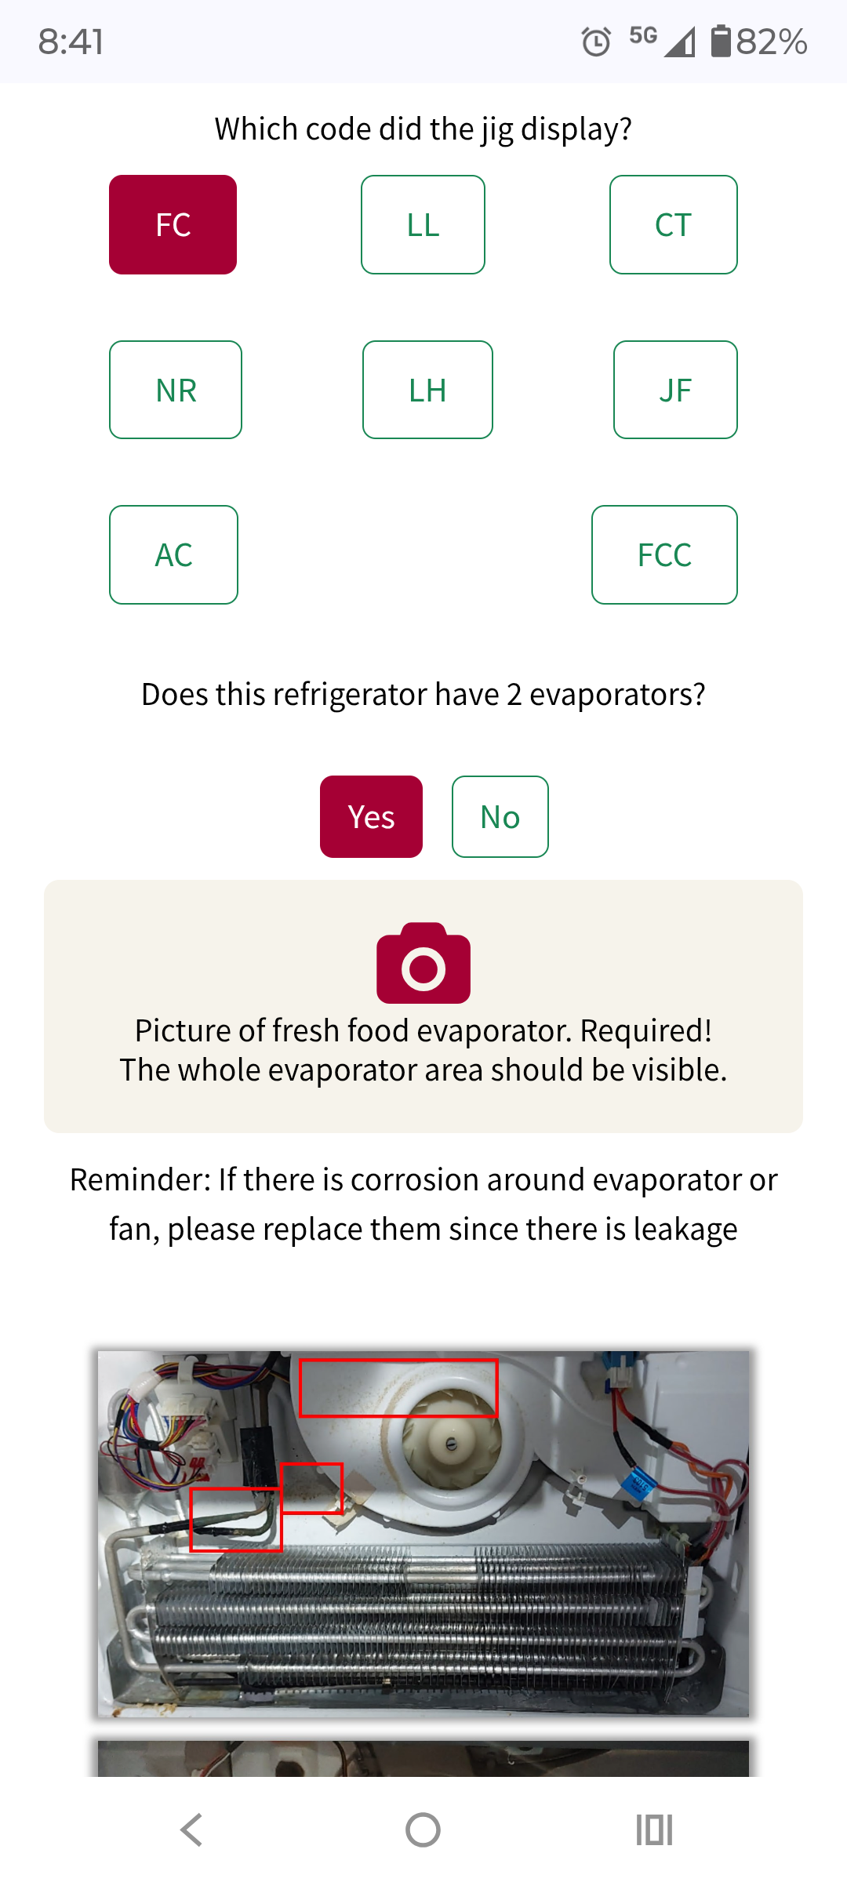
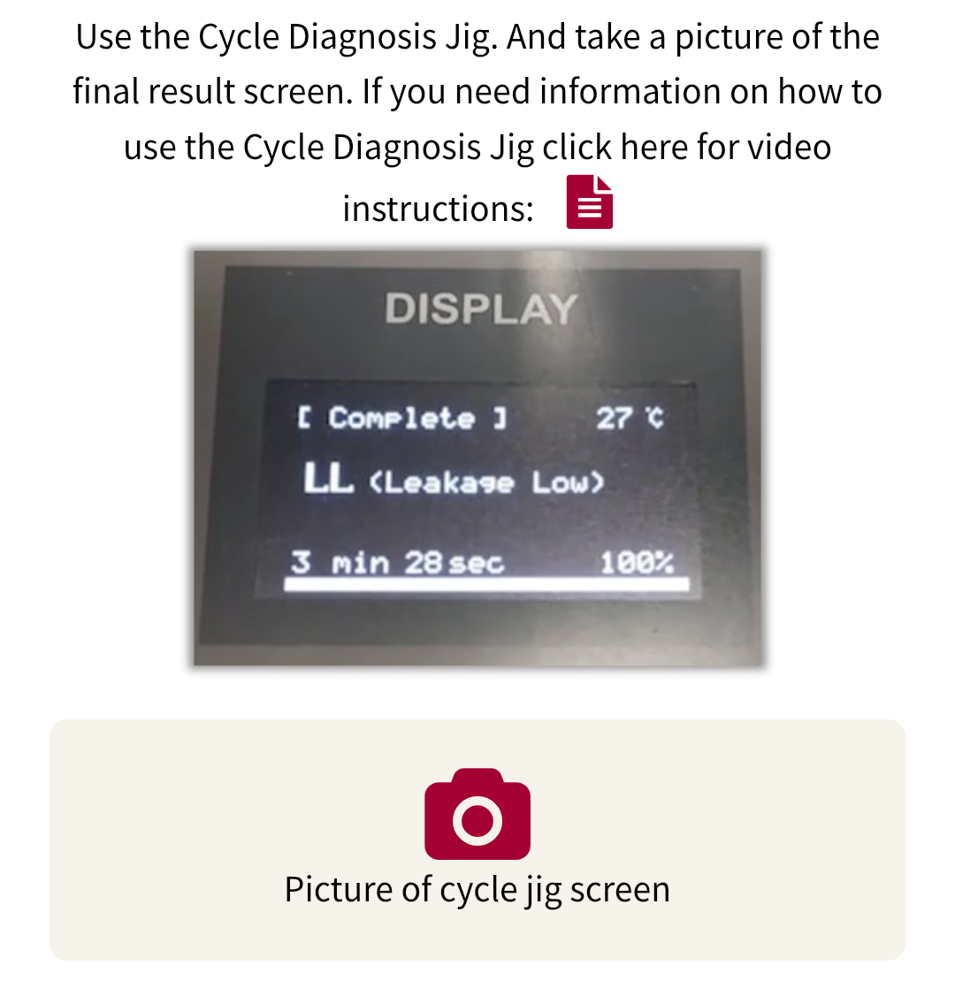
Pg.6
No Cool Checklist Update - November 2025
Step 3: Sealed System Diagnosis (FLD165/FMA)
Only Change is if tech selects “FC” or pressures indicate “Inefficient Compressor”, additional step added.
Tech will be asked if the unit has a FLD/FMA Compressor installed.
If So…
They will be asked to use the Sealed System Diagnosis Jig that was issued to all DMST.
Once the jig has completed diagnosis the tech will need to select what the final diagnosis answer was and take a picture of the screen showing the jig diagnosis.
Part Recommendation will be given when the tech selects the jig diagnosis answer.
Picture of Jig Diagnosis Screen is Required.
Additional Step:
Example: Leak found where suction line connects to compressor, no evap leaks found, will not need evaporator replacement.
Techs may sometimes run into unique situations. A comment box has been added where techs can freely explain what they are seeing that might require a different repair than the recommended parts.
If Diagnosis is FC or Inefficient compressor and unit is dual evaporator, tech will be asked for a picture of the fresh food evaporator area. Low side leaks often damage compressors.

Slide 7
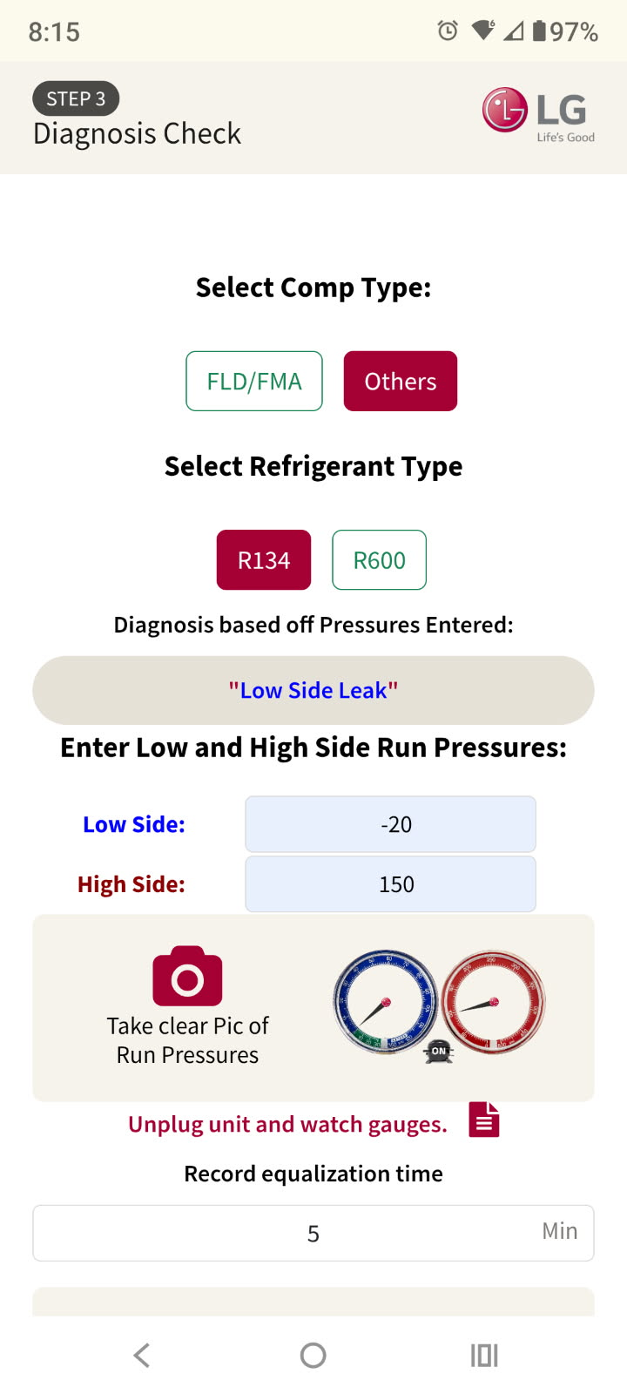
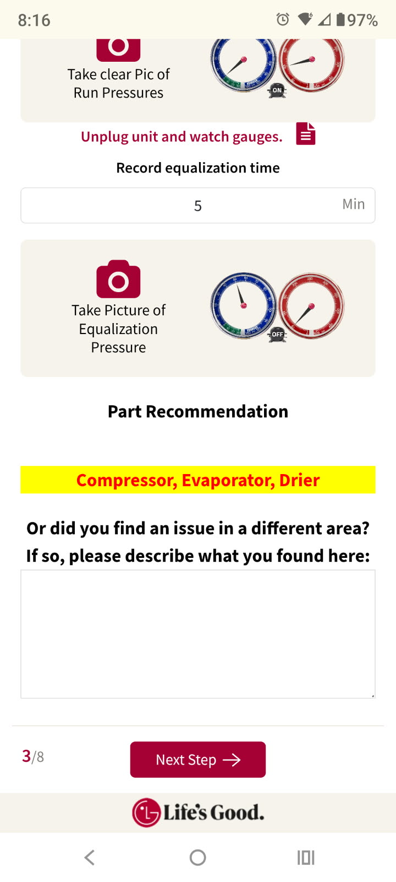
Pg.7
No Cool Checklist Update - November 2025
Step 3 Cont’d: Sealed System Diagnosis (Non FLD165/FMA)
Only Change is if tech selects “FC” or pressures indicate “Inefficient Compressor”, additional step added.
(See Example on Slide 6)
If the unit does not contain a FLD/FMA Compressor…
Tech will be asked to input Run Pressures and Equalization Time. Based off these readings a diagnosis will be given.
Part Recommendation will be given based off the diagnosis result.
Pictures of Run Pressures and Equalization Pressure will be required.
Diagnosis Result and Part Recommendation will appear once tech has entered:
1) Refrigerant Type
2) Low Side Run Pressure.
3) High Side Run Pressure.
4) Equalization Time.
Example: Leak found where suction line connects to compressor, no evap leaks found, will not need evaporator replacement.
Techs may sometimes run into unique situations. A comment box has been added where techs can freely explain what they are seeing that might require a different repair than the recommended parts.

Slide 8
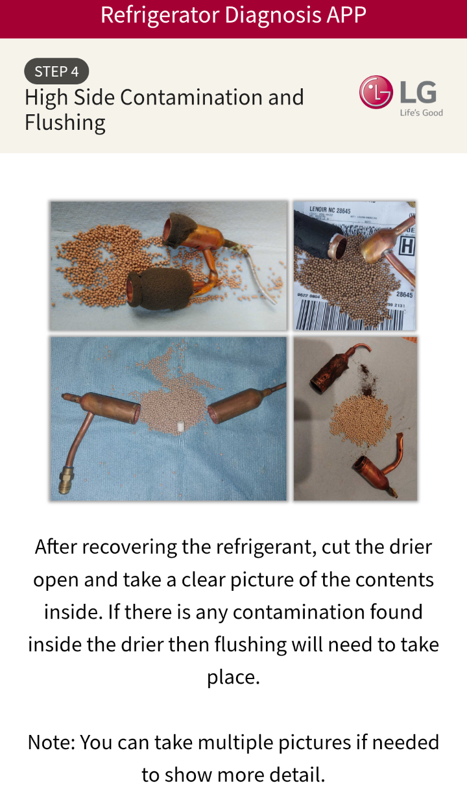
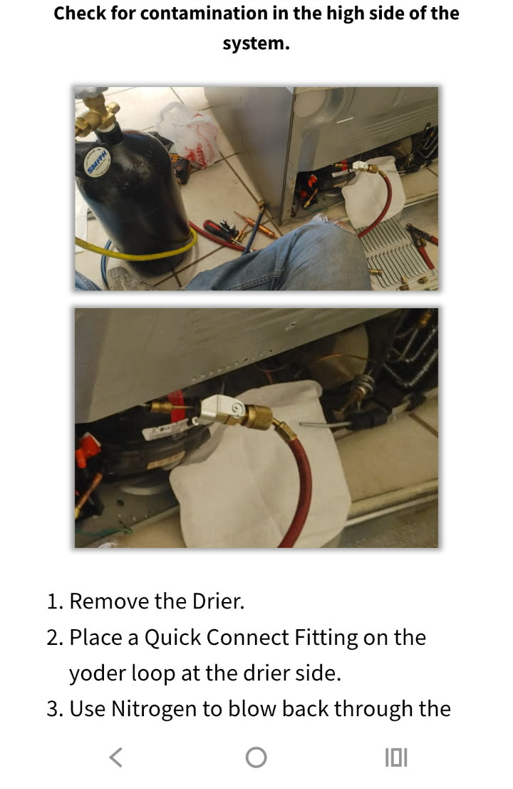
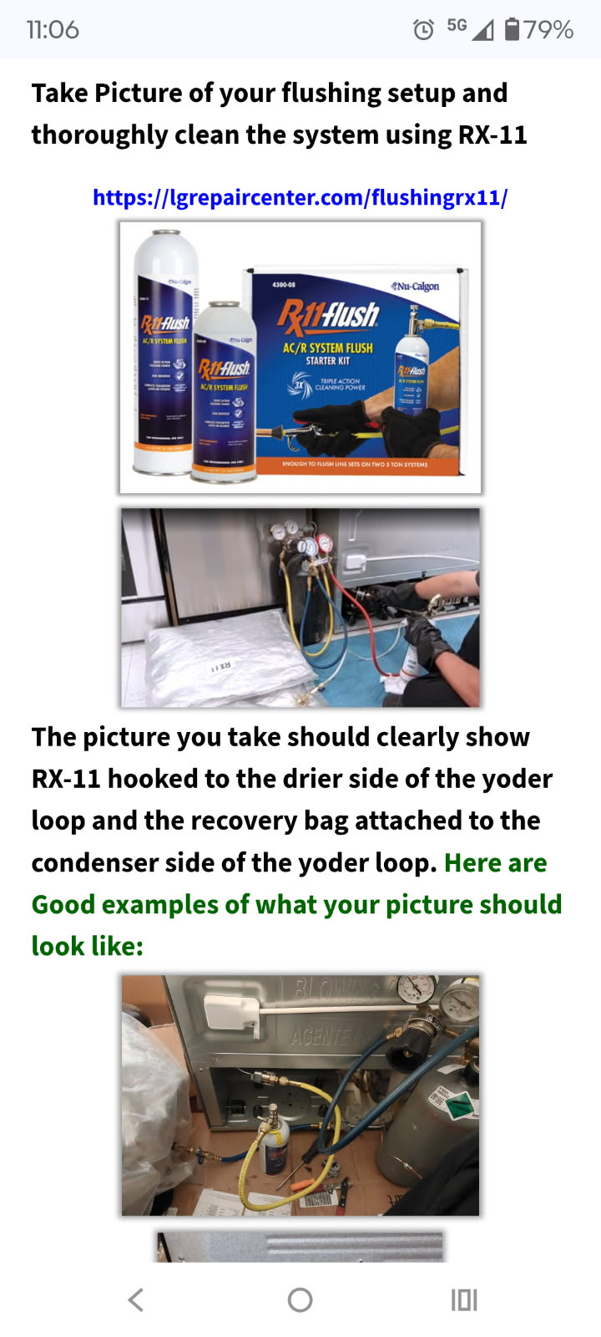
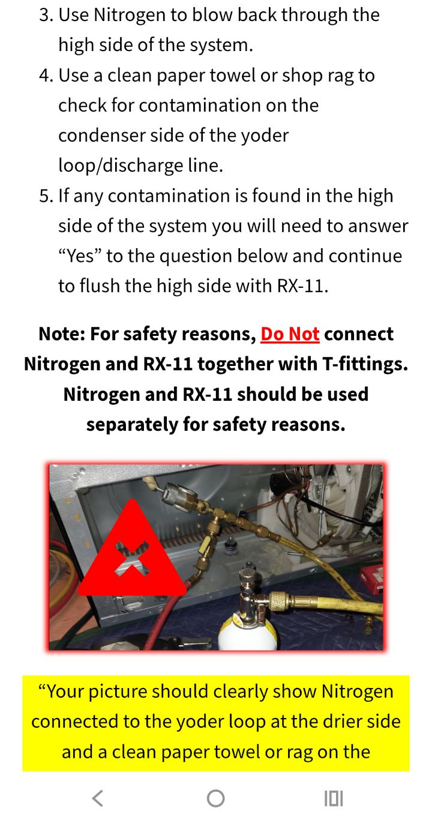
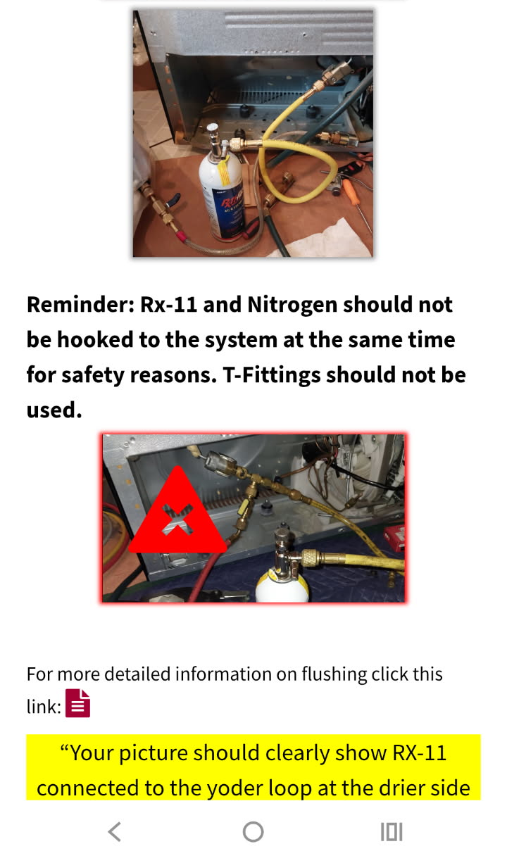
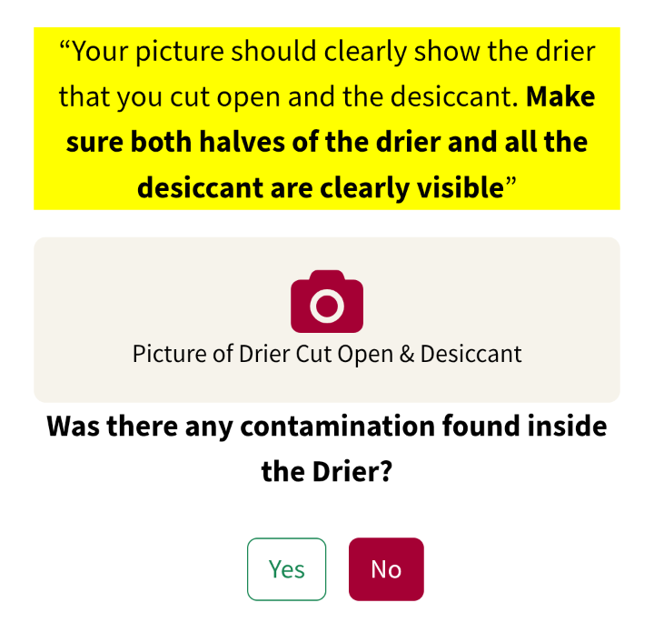
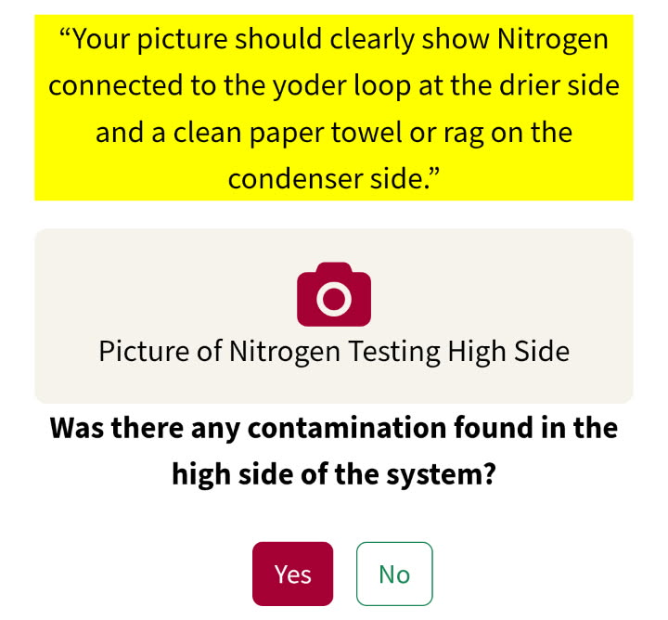
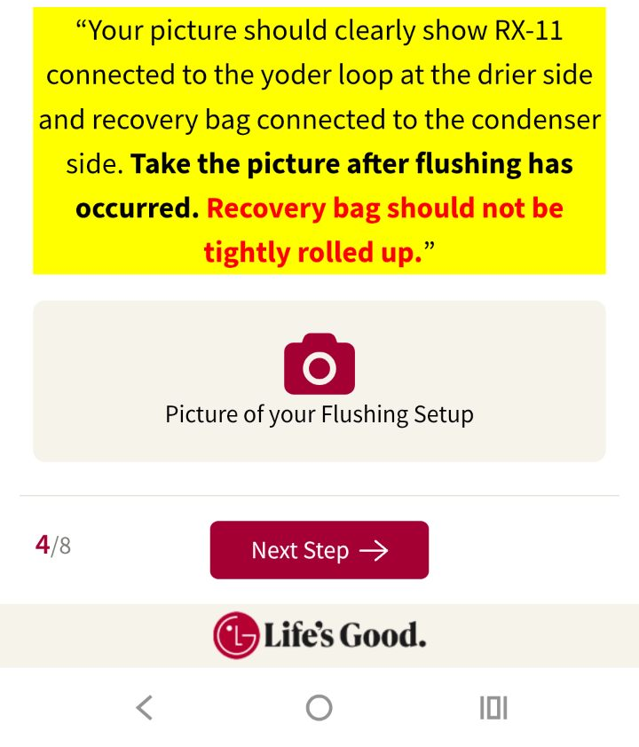
Pg.8
No Cool Checklist Update - November 2025
Step 4 : High Side Contamination & Flushing
On past checklists Step 4 was Contamination Check and Step 5 was RX-11 Flushing.
On this newest version of the checklist, High Side Contamination Check and RX-11 Flushing have been combined into one step.
Techs will still need to take pictures of the driers cut open and of the high side nitrogen test setup. (Note it is important that techs take the pictures exactly like the instructions on screen).
Depending on the results of the above tests and how the tech answers the yes/no questions, RX-11 flushing may or may not be required here at Step 4.
Note: for Techs under 10% reclaim… The only picture requirement in Step 4 would be the Flushing Setup picture if contamination was found.

Slide 9

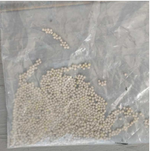
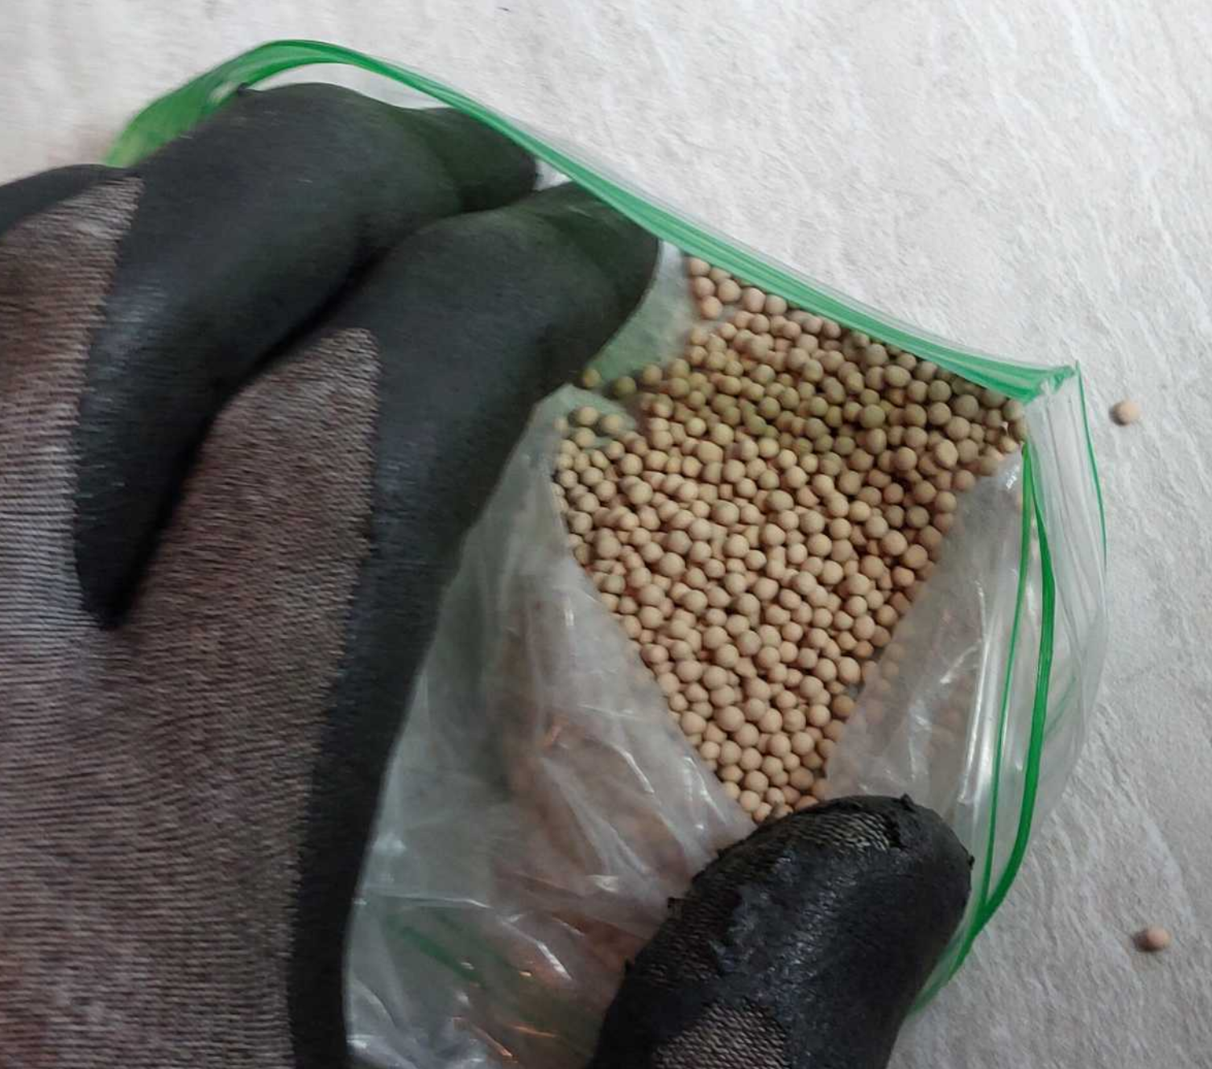
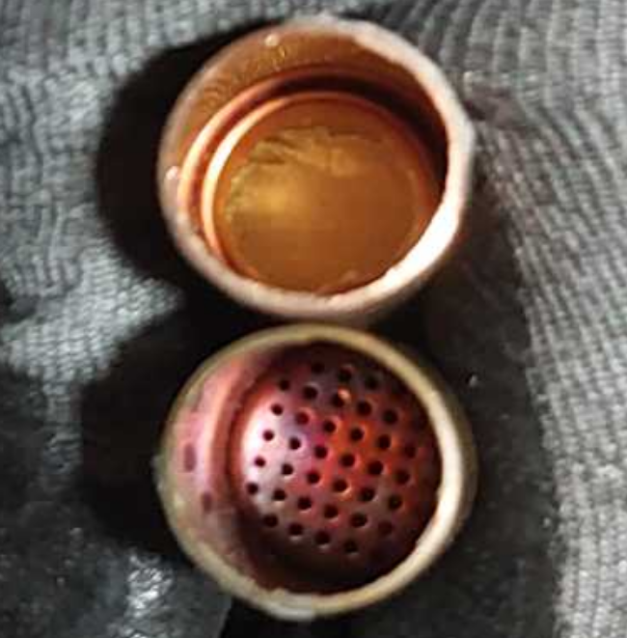
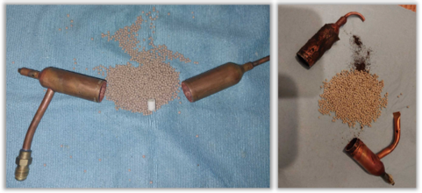
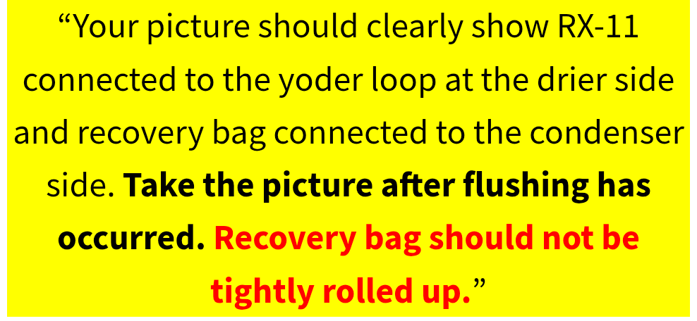
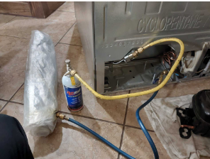
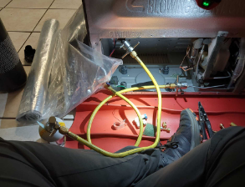
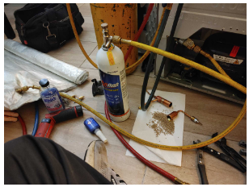
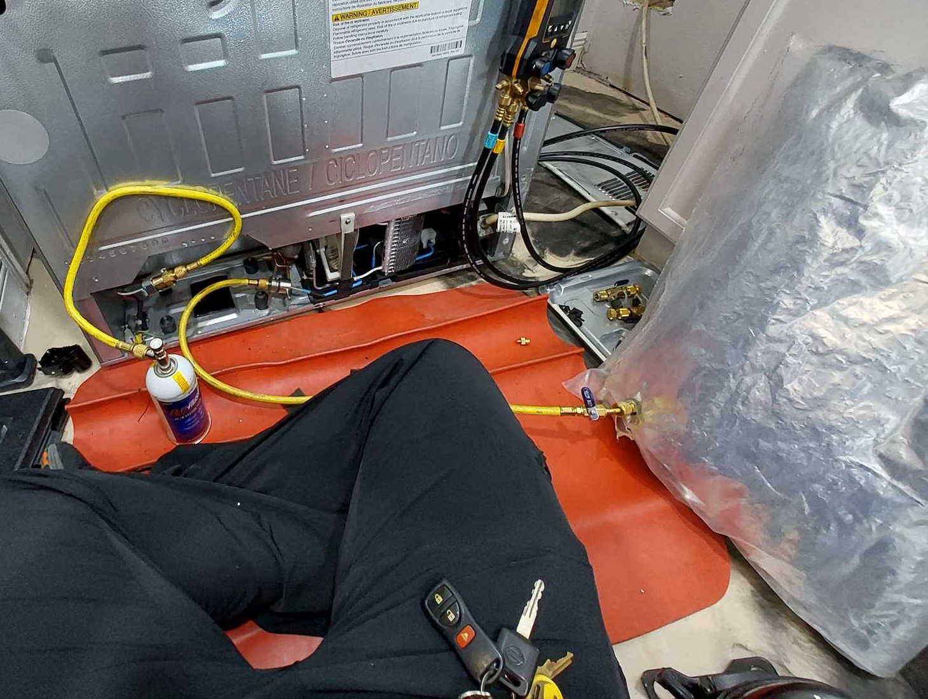
Pg.9
No Cool Checklist Update - November 2025
Step 4 : New Items Reviewers Will Be Checking For
1) Both halves of the drier and all the desiccant should be clearly visible in the picture.
- Several submissions only show the desiccant or just the drier.
- Both the drier and the desiccant should be visible in the picture(s).
Do Not Submit Incomplete Pictures:
2) Recovery bag should not be tightly rolled up.
- Pictures get submitted that look like the recovery bag has never been used.
- Take the Picture after flushing is completed. Bag should be expanded and clearly visible in the picture.
Take Pictures After Flushing Is Complete:

Slide 10
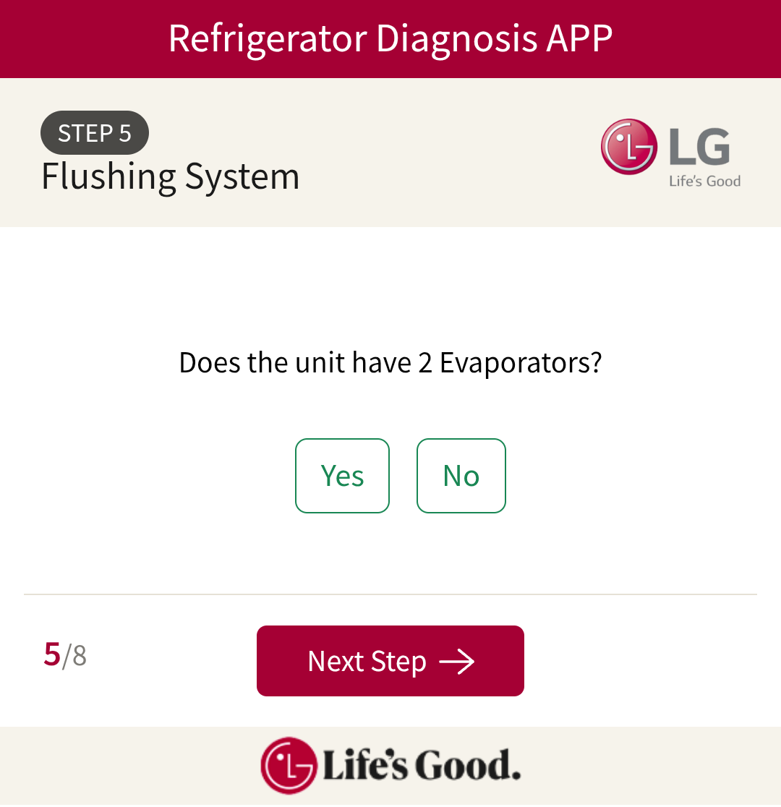
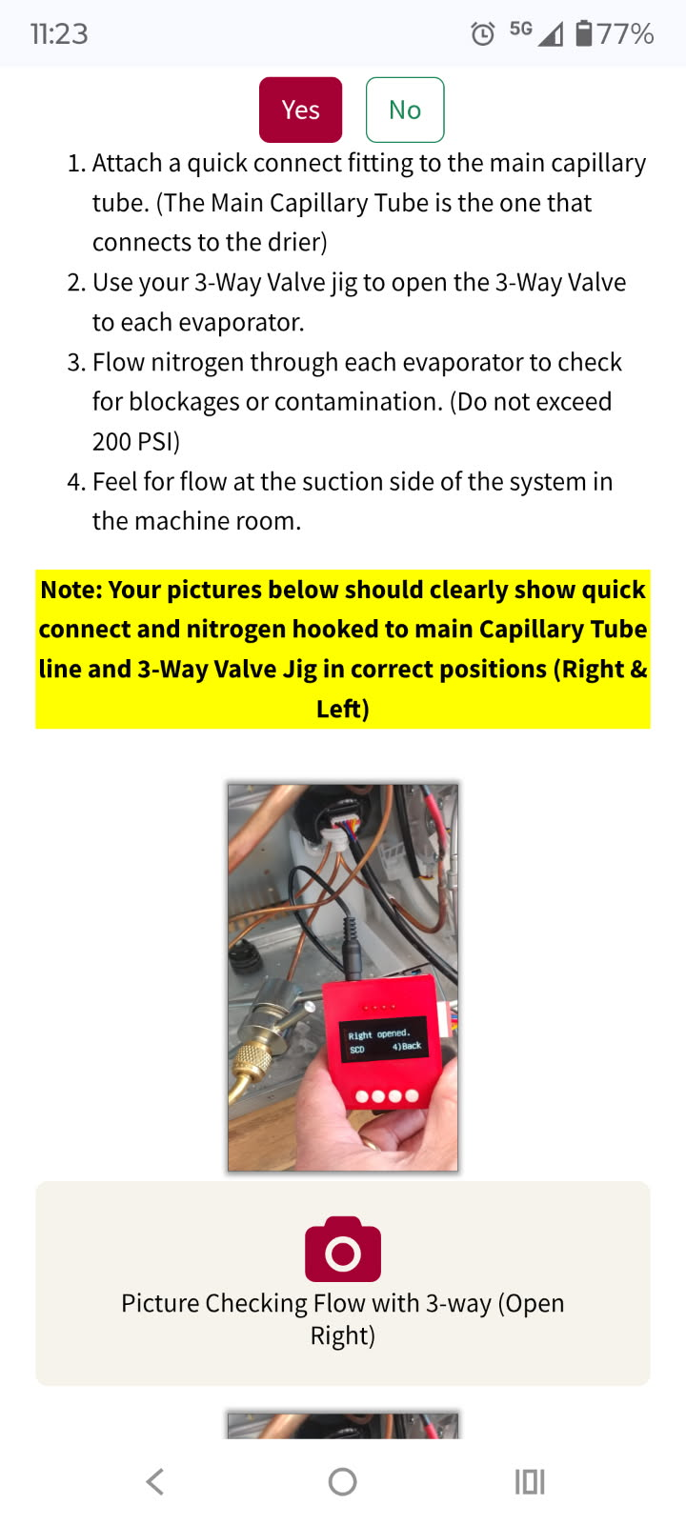
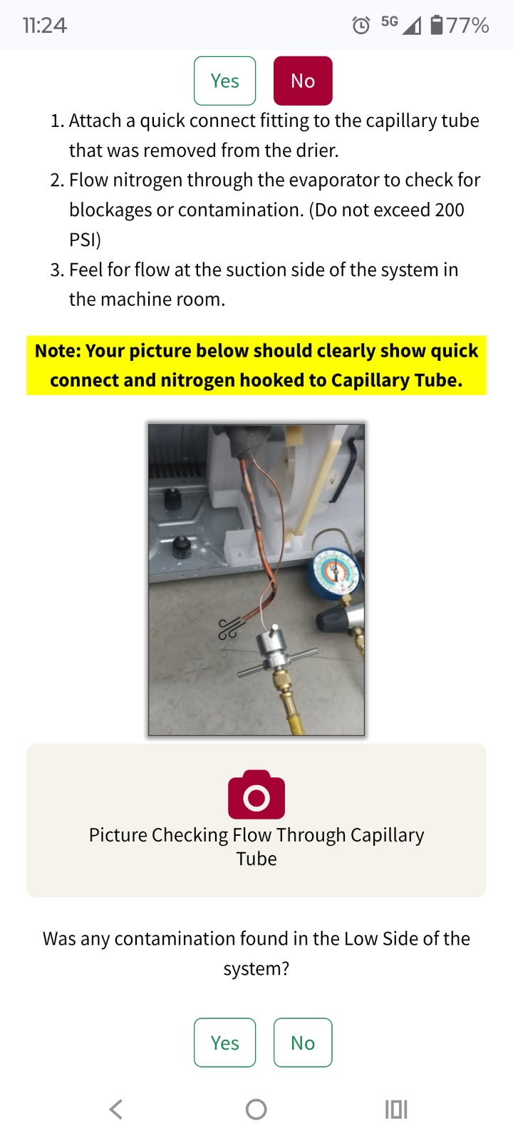
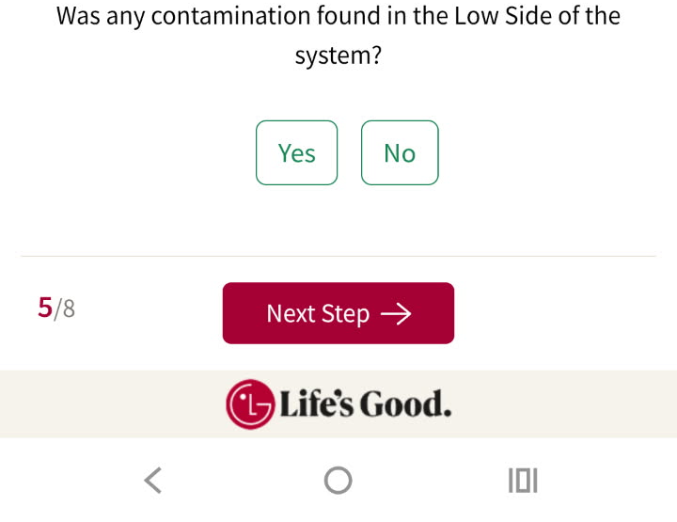
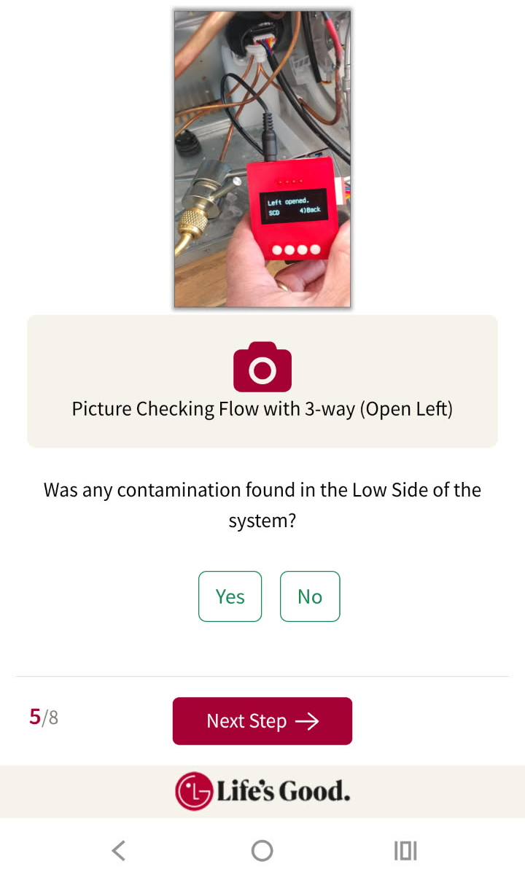
Pg.10
No Cool Checklist Update - November 2025
*NEW* Step 5: Low Side Contamination Check
Techs will be asked to check for contamination in the Low Side of the system.
Techs will need to answer the question… “Does the unit have 2 Evaporators?”
If the unit is dual evaporator, the techs will need to use their 3-way valve jig to move the valve to different positions and make sure all parts of the low side are clear from contamination and restrictions.
Pictures should clearly show… 1) Nitrogen connected to the capillary tube. 2) If dual evaporator should clearly show the 3-way valve jig connected and screen should be readable.
If Dual Evap:
If Single Evap:
Low Side Contamination Check
Note: for Techs under 10% reclaim… There are no picture requirements for Step 5. Techs simply answer Yes/No to the contamination found question.

Slide 11
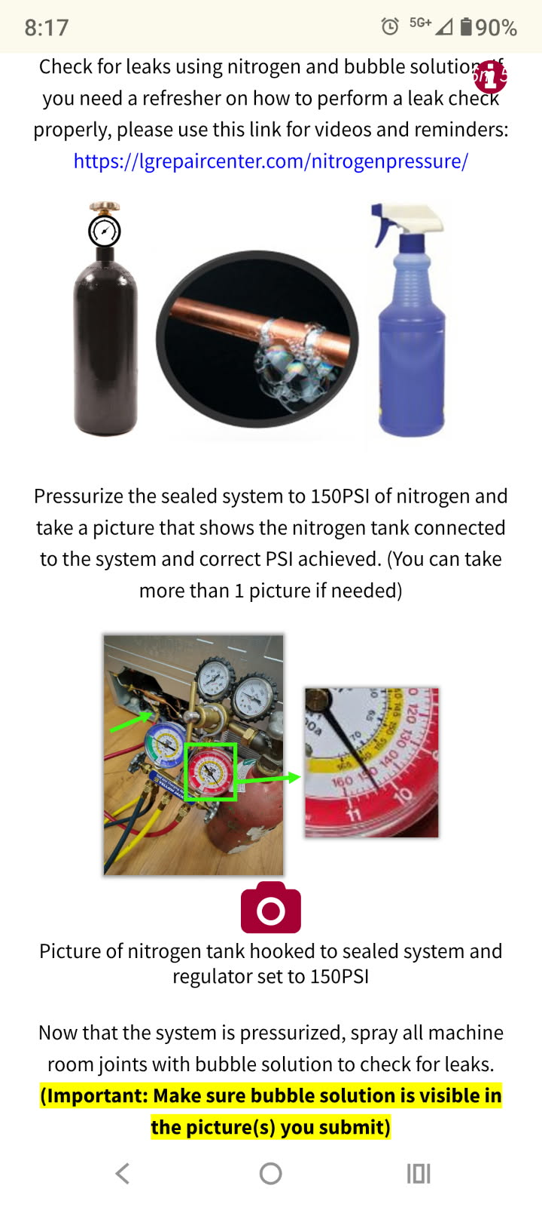
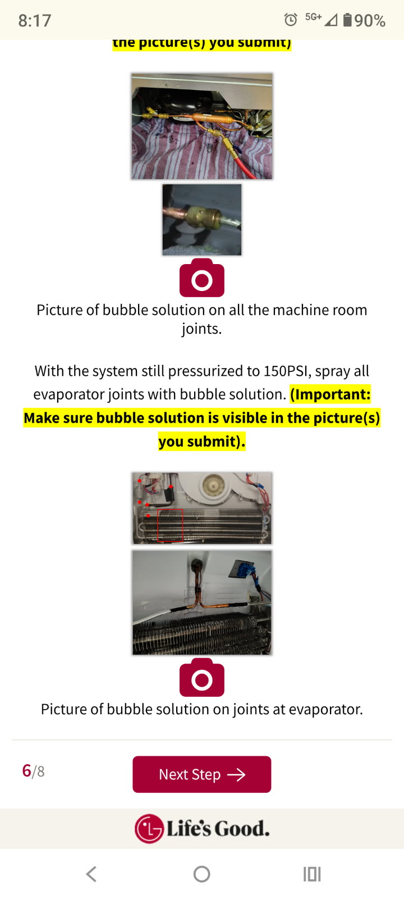
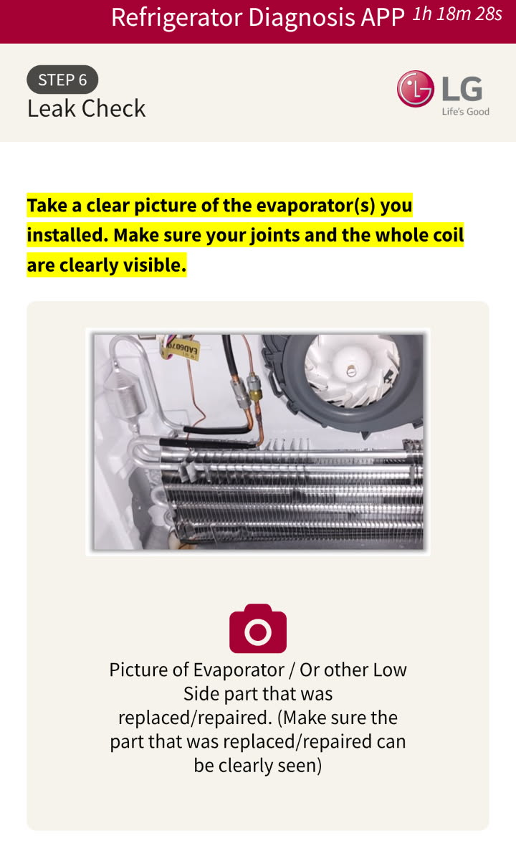
Pg.11
No Cool Checklist Update - November 2025
Step 6: Leak Check
The only change to Step 6 is that the Final Machine Room Picture was moved from here to Step 8.
If the diagnosis result called for an evaporator to be replaced, the evaporator picture(s) will still be taken here in Step 6.
Pressurize the system to 150 PSI and supply proof that proper leak testing took place. All machine room joints will need to be shown and evaporator joints if the evaporator was replaced.
It is important that in the pictures bubble solution can be seen on the joints.
Note: for Techs under 10% reclaim… The only picture requirement in Step 6 would be to show the evaporator replacement picture if an evaporator coil was called for in Step 3. Leak Checking Pictures are skipped for under 10% reclaim.
If techs need a refresher on how to perform leak checks, they can use this link: https://lgrepaircenter.com/nitrogenpressure/
This article gives multiple examples of leak points and how to videos.

Slide 12
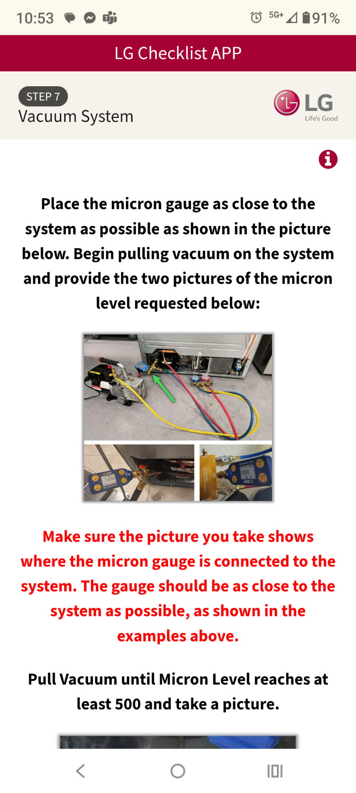


Pg.12
No Cool Checklist Update - November 2025
Step 7: Vacuum System
There is no change from the current checklist.
Pull down to 500 microns (or lower) and take the first picture.
A 10-minute timer will start when the first picture is taken. Continue to run the vacuum pump for the 10-minute duration.
Take a picture of the lowest micron level achieved after the 10 minutes is complete. (Expectation is that the final micron level should be lower than the 500 micron start point)

Slide 13








Pg.13
No Cool Checklist Update - November 2025
Step 7 : New Items Reviewers Will Be Checking For
1) Make sure all valves are open during the vacuum pictures.
Several submissions submitted recently show valves closed during the vacuum process.
If using the “Vacuum Jig” make sure all valves are visible and in the open position.
Do Not Submit Pictures With Valves Not Visible or Closed:

Slide 14










Pg.14
No Cool Checklist Update - November 2025
Step 8: Final Operation Checks
The Final Machine Room Picture has been moved to Step 8. Techs need to take this picture right before putting the back cover on the machine room. Drier should be strapped in the bracket, tubing neatly tucked away, and condenser should be clean.
New additions to Step 8 include… Verifying Fan Operation, Verifying Icemaker Test Mode, and checking for Software Updates.
Note: The software update feature for compressor may be added at a future time. Currently, it will be able to tell the tech if the unit requires a software update for the Craft Icemaker.
Will show Craft Icemaker Software Update needed for now. Hope to add Compressor function in the future.

